Slide 1
Lesson 7: Servo Motor Control

Slide 2
CuteBot Rules:
If you break any of these rules, you can choose:
Only run bots on designated mats
Limit speed to < 75% (unless otherwise specified)
Unplug batteries when not in use
Do not drop the CuteBots
Do 3 burpees
Sing "I'm a Little Teapot" song
Do 10 jumping jacks
Notes:
CuteBot and Construction Expectations +

Slide 3
DEBUG Broken Controller
We have a controller and a CuteBot with the desired control scheme:
Press A --> turn LEFT
Press B --> turn RIGHT
Press A+B -->
If CuteBot is moving, stop moving
If CuteBot is not moving, start going straight again
However, pressing A+B makes the robot stop regardless of whether or not it was previously moving
Next slide contains our buggy code

Slide 4
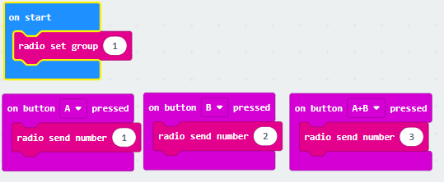
DEBUG Broken Controller
Controller Code:
A corresponds to signal 1
B corresponds to signal 2
A+B corresponds to signal 3

Slide 5
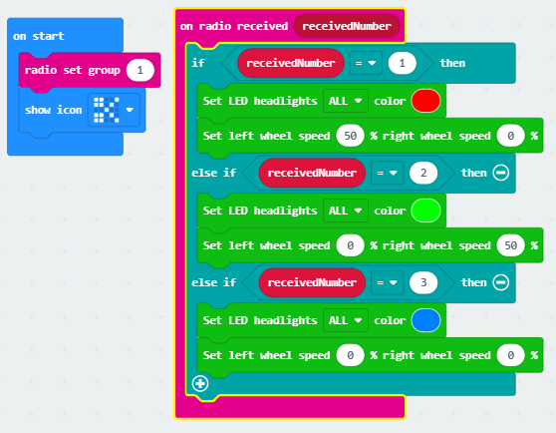
DEBUG Broken Controller
CuteBot code:
Pressing A+B always make the robot stop
We want it to stop only if it is already moving
We want it to go in a straight line if A+B is pressed while the robot is stationary
Any ideas?

Slide 6
DEBUG Broken Controller
Create a "moving" variable
Moving = 1 will indicate that the robot is currently moving
Moving = 0 will indicate that the robot is currently stationary
What should "moving" be initialized to?
When should we update "moving"?
Any ideas?

Slide 7
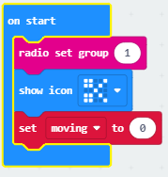
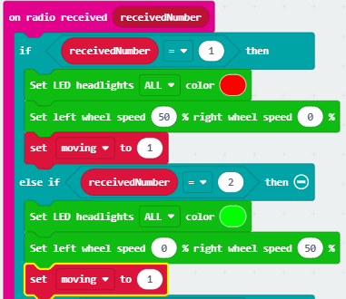
DEBUG Broken Controller
Initialize moving to 0 (robot is not moving at start)
Update moving when A or B are pressed

Slide 8
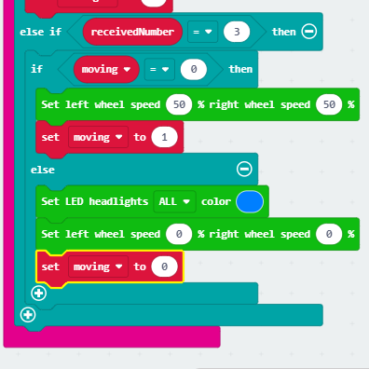
DEBUG Broken Controller
When A+B is pressed, check status of "moving"
If currently moving, then stop
If not moving, start moving in a straight line
Remember to update "moving" again

Slide 9
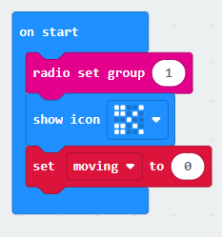
DEBUG Broken Controller SOLUTION

Slide 10
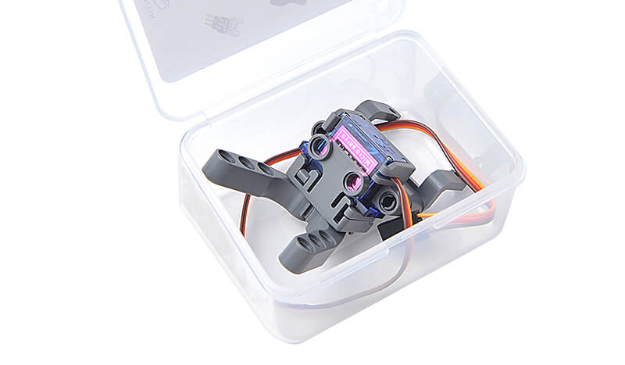
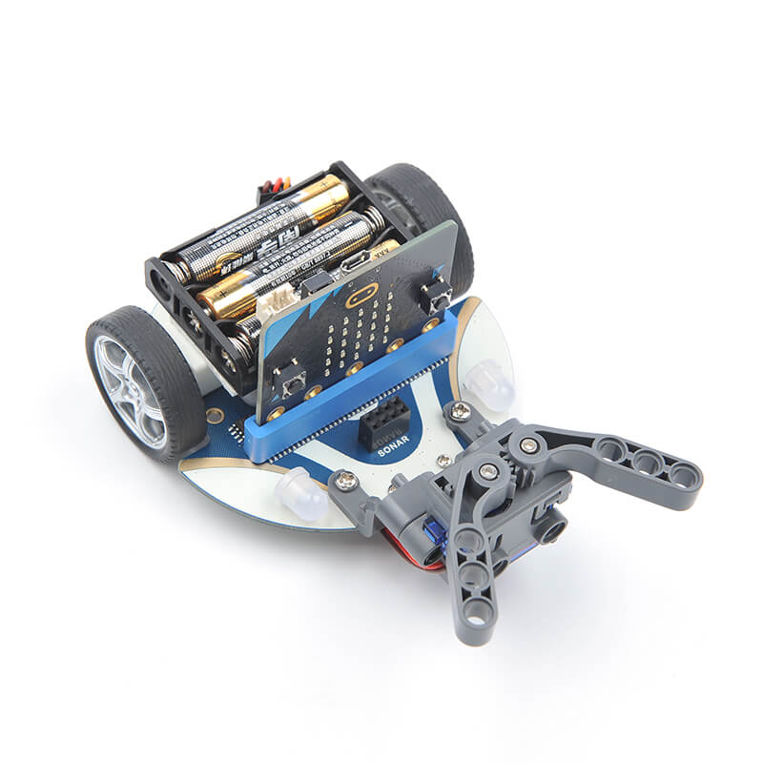
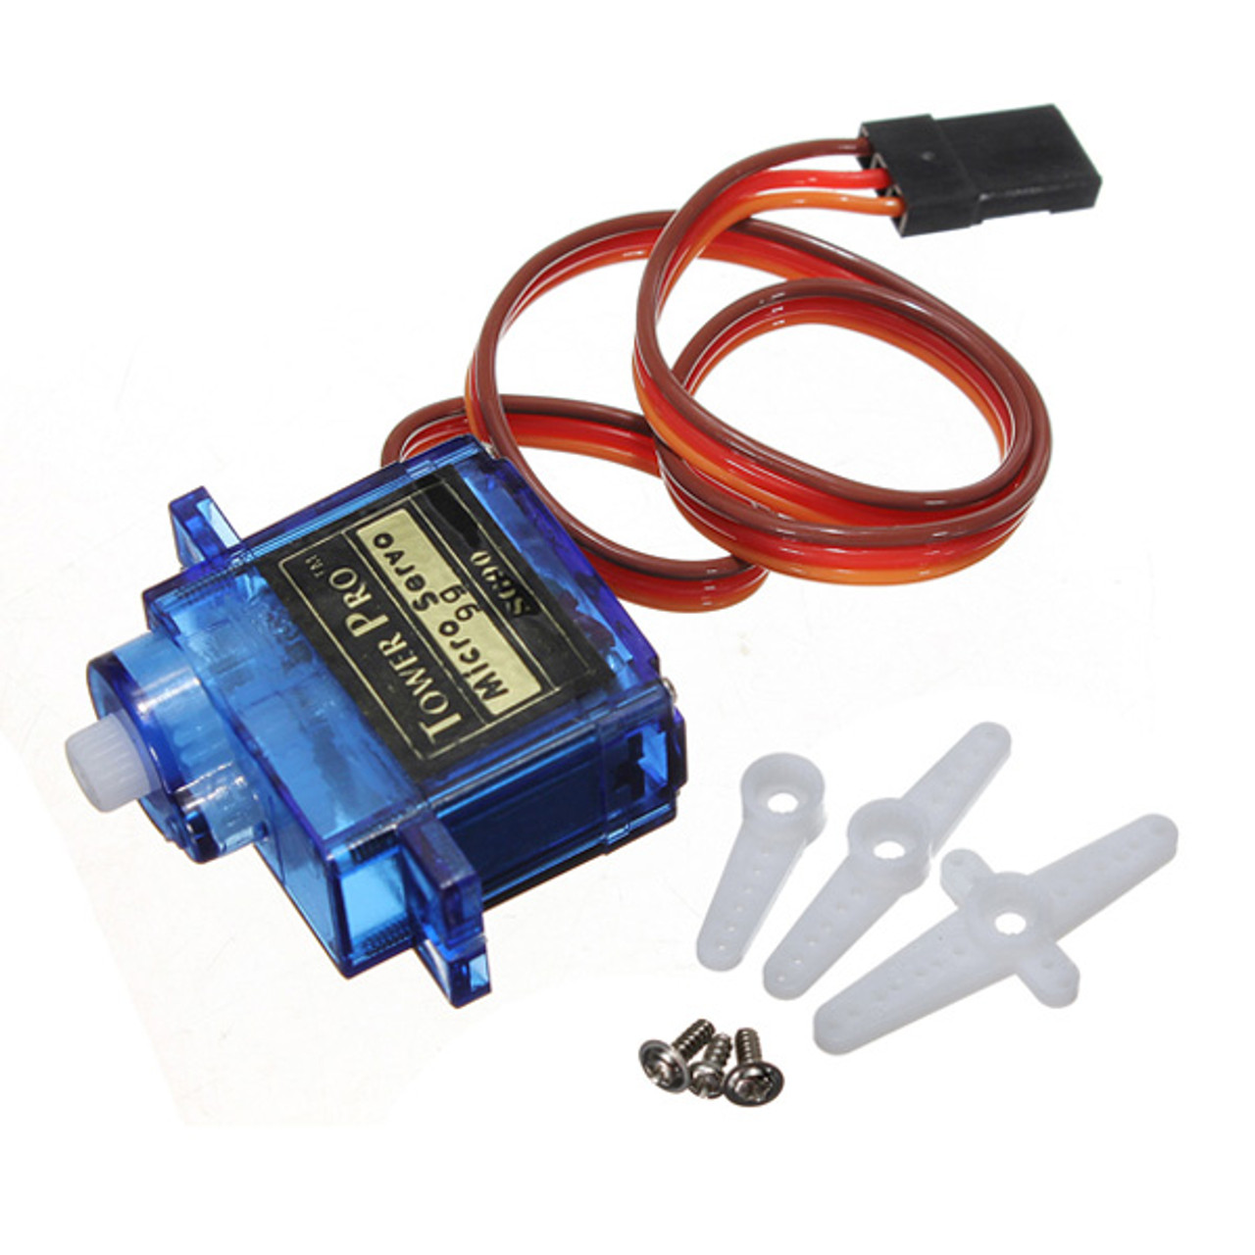
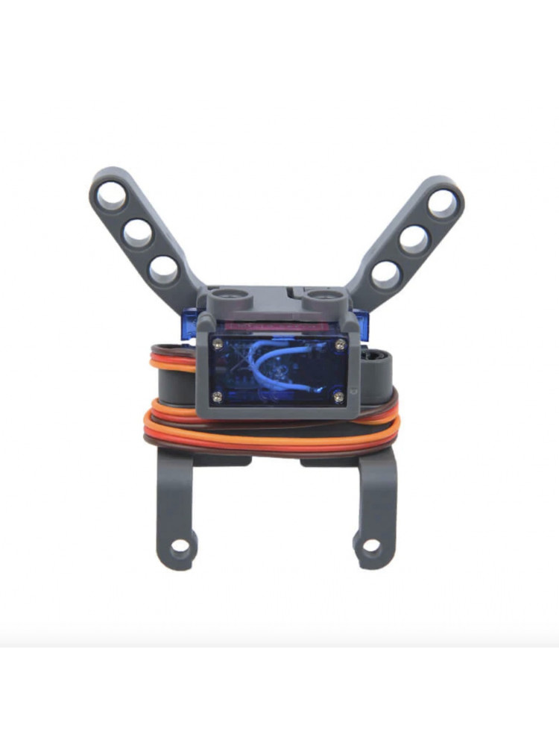
SERVO Motors for CuteBots
Notes:
Image from https://www.pishop.ca/product/sg90-180-degrees-9g-micro-servo-motor-tower-pro/

Slide 11
SERVO Motors
Servo motors or “servos” are electronic devices that rotate and push parts of a machine with precision and efficiency
They have many applications
Used in cameras to precisely correct the lens for focusing
Used in automatic doors
They are even used in rocket ships!
Can you think of any other uses for servos?
Notes:
Image from https://www.pishop.ca/product/sg90-180-degrees-9g-micro-servo-motor-tower-pro/

Slide 12
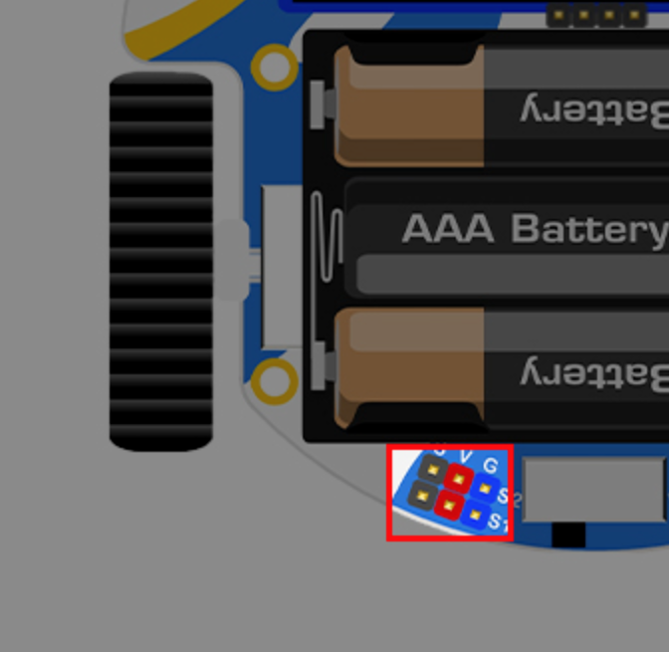
Connecting our Servos
We can program out Servo using our Micro:Bits and the pins on our Cutebot
First we need to connect out Servo to out Cutebot using the pins labelled S1
The brown wire connects to Ground
The red wire connects to Voltage
The yellow wire connects to Signal
Notes:
Image from https://www.pishop.ca/product/sg90-180-degrees-9g-micro-servo-motor-tower-pro/

Slide 13
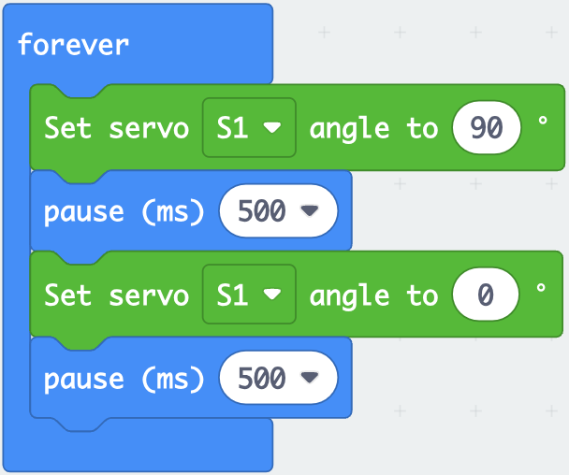
Programming the Servos
Our Cutebot extension already has all of the code blocks we need!
Try creating and running the following program
What happens?
Change the numbers! What changes? (Keep the angles between 0-180)
Notes:
Image from https://www.pishop.ca/product/sg90-180-degrees-9g-micro-servo-motor-tower-pro/

Slide 14
Seeking Light Challenge
When light is hitting the Cutebot, it will open its servo arms move straight
When it is in the dark, it will close its arms and move in random directions
Remix:
Use the LED screen to show pictures depending on where the Cutebot is
Play music/sound while the Cutebot moves
Notes:
Image from https://www.pishop.ca/product/sg90-180-degrees-9g-micro-servo-motor-tower-pro/

Slide 15
Forklift Challenge
Using a remote control and our movement blocks alongside these new servo blocks, create a program that:
Goes forward and opens its servo catch arms when the A button on the Micro:Bit is pressed
Goes backwards and closes its servo catch arms when the B button the Micro:bit is pressed
Does a special dance when both are pressed
Remix:
Add Music/Sounds to signal when the cutebot is moving forward/backwards
Use the LED headlights
How would you add the ability to turn?
Notes:
Image from https://www.pishop.ca/product/sg90-180-degrees-9g-micro-servo-motor-tower-pro/

Slide 16
Q&A
What are Servo Motors?
What other technology on the Micro:Bit or Cutebot did we use today?
How could we use this technology to build robots?
Where might we see motors used in real life?
Notes:
Image from https://www.pishop.ca/product/sg90-180-degrees-9g-micro-servo-motor-tower-pro/

