Slide 1
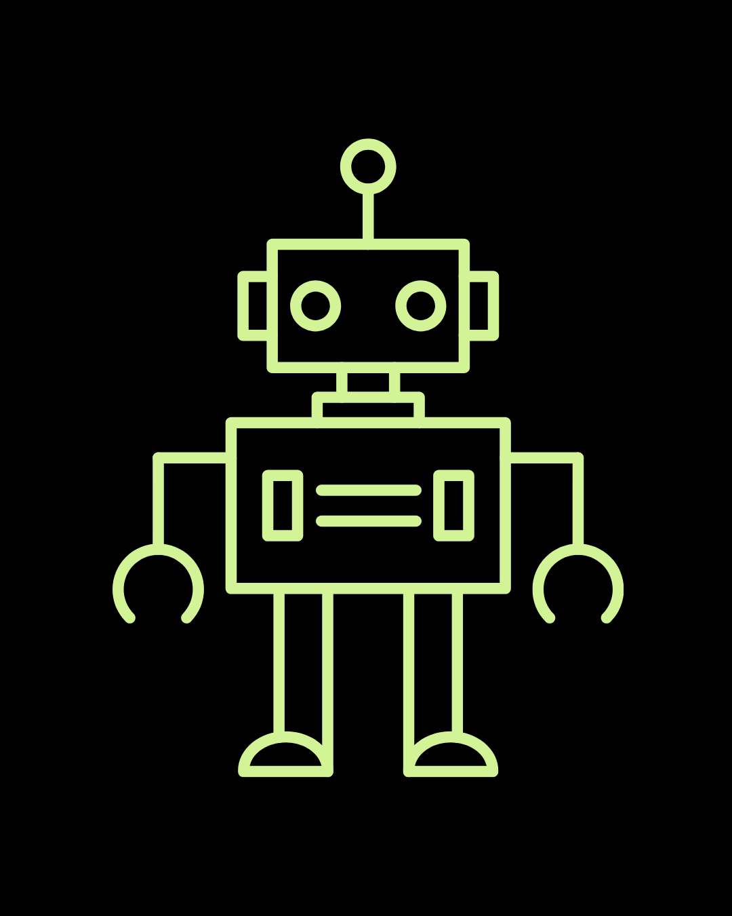
Lesson 6: Radio Signals & Remote Control

Slide 2
Review
What sensor did we learn about last class? What does it do?
How does technology do we use in the real world that uses this sensor?
Notes:
Ultrasonic sensors: electronic device that measures the distance of a target object by emitting ultrasonic sound waves
Ex: vehicle detection in car washes

Slide 3
CuteBot Rules:
If you break any of these rules, you can choose:
Only run bots on designated mats
Limit speed to < 75% (unless otherwise specified)
Unplug batteries when not in use
Do not drop the CuteBots
Do 3 burpees
Sing "I'm a Little Teapot" song
Do 10 jumping jacks
Notes:
CuteBot and Construction Expectations +

Slide 4
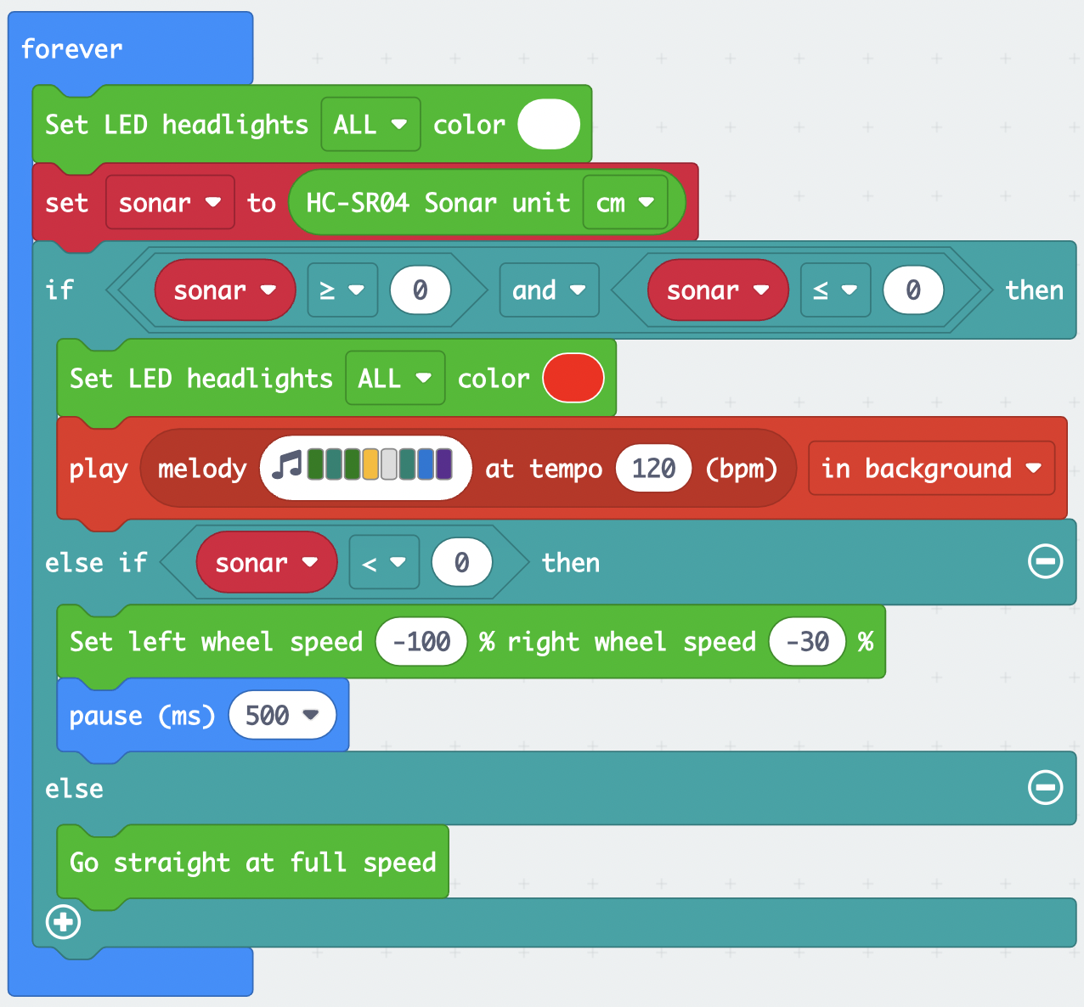
Debug Challenge #1
This is a lot of code!
Lets go through it step by step
Lets debug it!
What numbers should I put if I want it to make the lights red if it sees something 5-10cm away
Else if it sees something less than 5 cm away (right in front), it backs up
Notes:
Demo the Solution!
Debug: https://makecode.microbit.org/_8tqFE0eYPc19
Solution: https://makecode.microbit.org/_LHr6RbLgHJty

Slide 5
What are Radio Signals?
Radio waves are a type of electromagnetic radiation
These waves are a lot longer than the waves of visible light.
This means we can't see radio waves!
Radio waves are often used in communication
Can you think of some other ways we can use radio waves?
Our Micro:Bits can use radio signals to communicate with each other!
What are some real-world examples of technology that uses radio waves?
The radio, Walkie-talkies, etc.

Slide 6
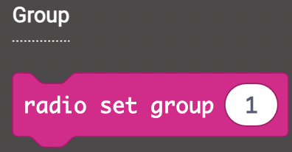
Remote Controllers
One way we can use radio waves is by creating a remote controller for our Cutebots!
By having one micro:bit acting as a controller and another inside of the Cutebot, we can send radio signals between the two
Both micro:bits need to be on the same radio group to communicate
Make sure you pick a unique radio group
If other students are using the same radio group as you, then the Cutebots may get confused. Why?

Slide 7
Remote Control Programming
Our remote controller needs code that sends numbers to the Cutebot based on user input
What kinds of input does a micro:bit have?
Buttons, accelerometer, microphone, etc.
On input: send number through radio
What would this look like in code?
Possible solution on next slide

Slide 8
Remote Control Programming

Slide 9
Cutebot Programming
What should our Cutebot do when it receives numbers via radio signal?
With our previous code:
Number 1 corresponds to button A (left side of controller)
Number 2 corresponds to button B (right side of controller)
Number 3 corresponds to A+B
Consider the following control scheme:
Number 1 means turn left
Number 2 means turn right
Number 3 means go straight
How would you code this?

Slide 10
Cutebot Programming
REMIX:
How can we make our Cutebot stop?
How could we make our Cutebot go backwards?

Slide 11
Remote Control with Accelerometer
We can use the accelerometer in our remote controller to control our Cutebot!
Remember to set controller and Cutebot to same radio group
We can also send strings via radio (not limited to just numbers)
We will send "x" and "y" values to our Cutebot
Set x to "acceleration (mg) x" divided by 10
Set y to "acceleration (mg) y" divided by 10
How often should we send these values?

Slide 12
Remote Control with Accelerometer

Slide 13
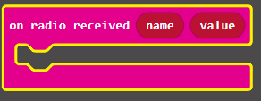
Cutebot Programming with Accelerometer
Since we are sending strings, the Cutebot will need to respond to received strings instead of numbers
We will use variables xValue and yValue, and we will update these variables when new values are sent
Then we will set the Cutebot's wheel speed based on the values stored in xValue and yValue
Name is the name of the string sent ("x" and "y")
Value is the value stored in name

Slide 14
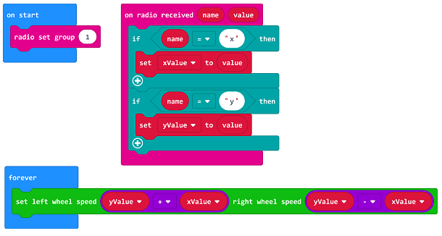
Cutebot Programming with Accelerometer
How can we make the controller more or less sensitive?

Slide 15
Challenge 1: Advanced Controller
Program a controller that can make your Cutebot do all of the following:
Go straight
Turn left
Turn right
Go backwards
Stop and start
Turn LED lights on and off
Make sounds
REMIX: add more functions to your controller

Slide 16
Challenge 2: Secret Message
A Micro:bit in the room is sending a secret message
It sends a string every 0.1 seconds
Code your micro:bit to find the message and follow the instructions given in the message
How will you find the right radio group?
The secret message will be sent using a radio group in the range of 1 to 100
Once you have sucessfully completed the task, the micro:bit will play you a song
Notes:
Link to the secret message sender:
https://makecode.microbit.org/_ee2JiRcp5abv
Download this code to a micro:bit and run it while the students are trying to decode the message
A possible solution to the challenge:
https://makecode.microbit.org/_2j0bjaTwkDvT

Slide 17
Q&A
What are radio signals?
Where are they used? Real world examples?
How many Micro:bits to do we need to program a remote controlled Cutebot?
What types of input can we use to tell our Micro:bits to send radio signals?
Notes:
Radio waves are a type of electromagnetic radiation
They areused for communication. Example: car radio
At least 2
Buttons, accelerometer, etc.

