Slide 1
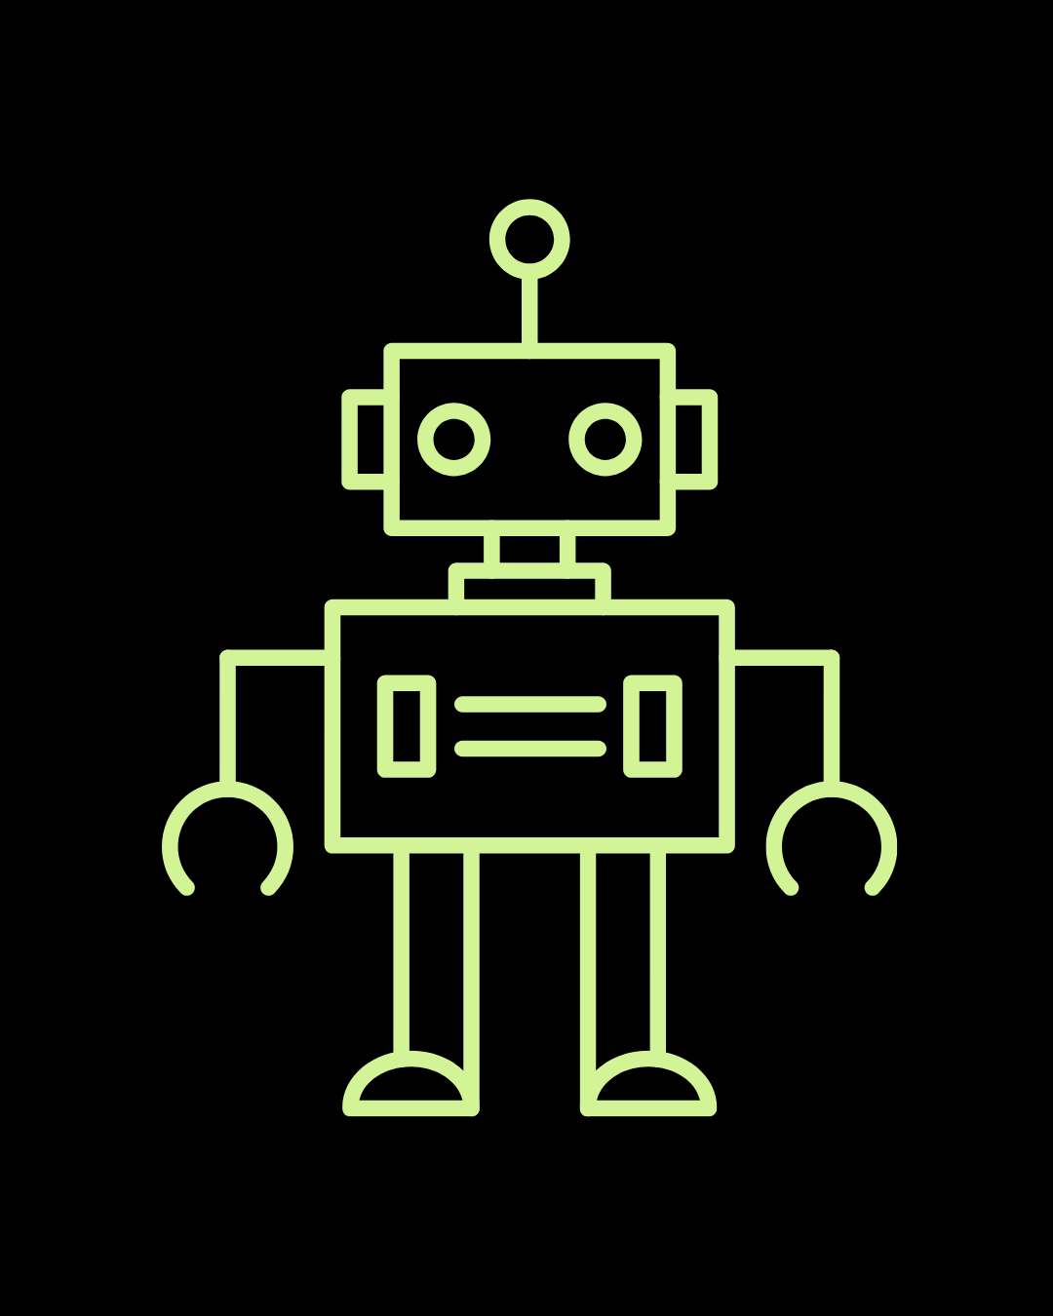
Lesson 5: Obstacle Avoidance

Slide 2
CuteBot Rules:
If you break any of these rules, you can choose:
Only run bots on designated mats
Limit speed to < 75% (unless otherwise specified)
Unplug batteries when not in use
Do not drop the CuteBots
Do 3 burpees
Sing "I'm a Little Teapot" song
Do 10 jumping jacks
Notes:
CuteBot and Construction Expectations +

Slide 3
What is Obstacle Avoidance?
Obstacle avoidance is a subsection in the study of robotics
Deals with autonomous navigation and control systems
Allows a robot to detect and avoid obstacles in its path to reach a predefined destination
Used in self-driving cars, space exploration, etc.
Can you think of any other examples?
How to detect obstacles? Using sensors!!
Can also use path-finding algorithms

Slide 4
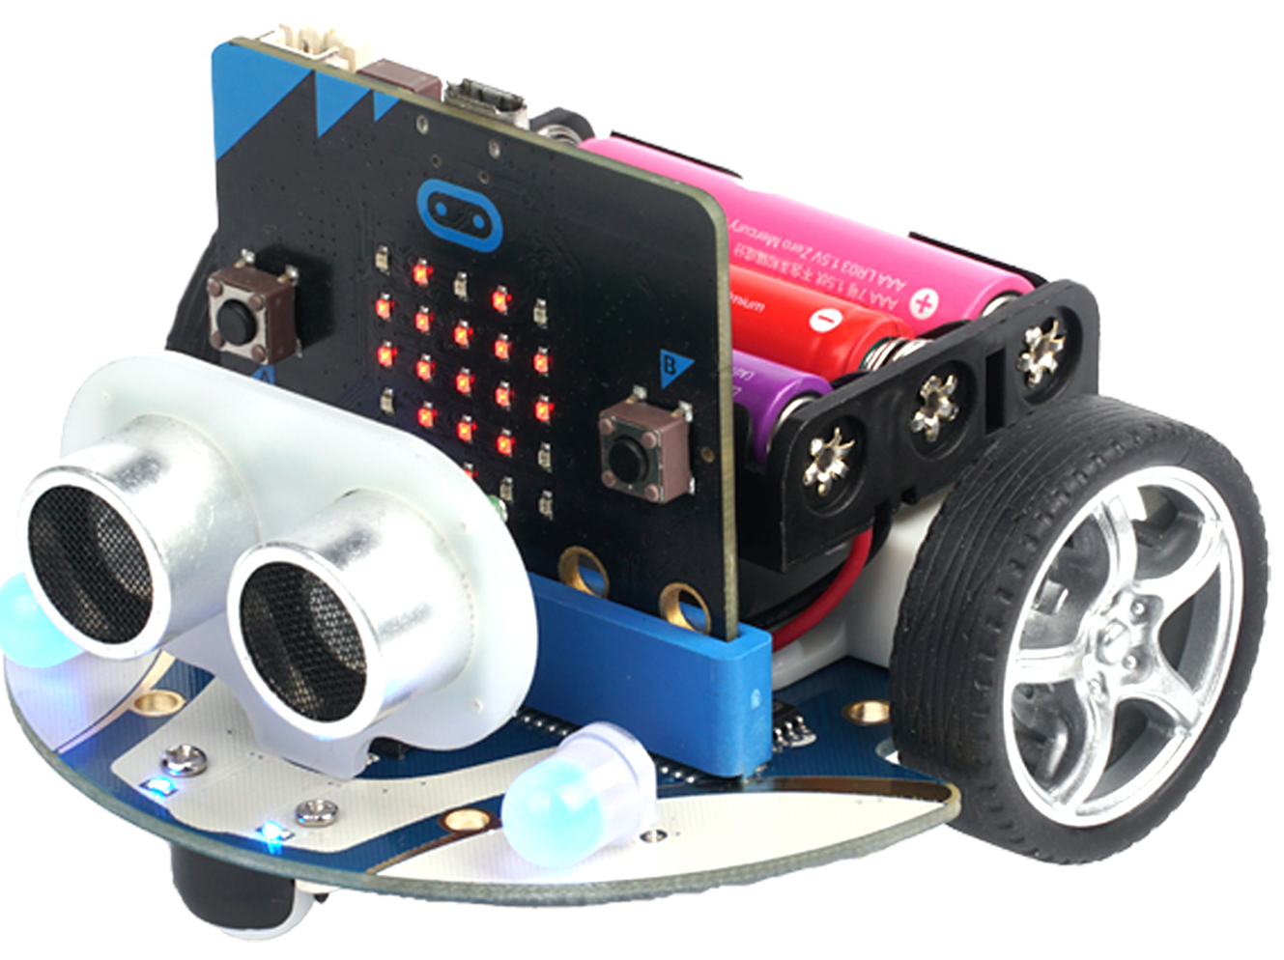
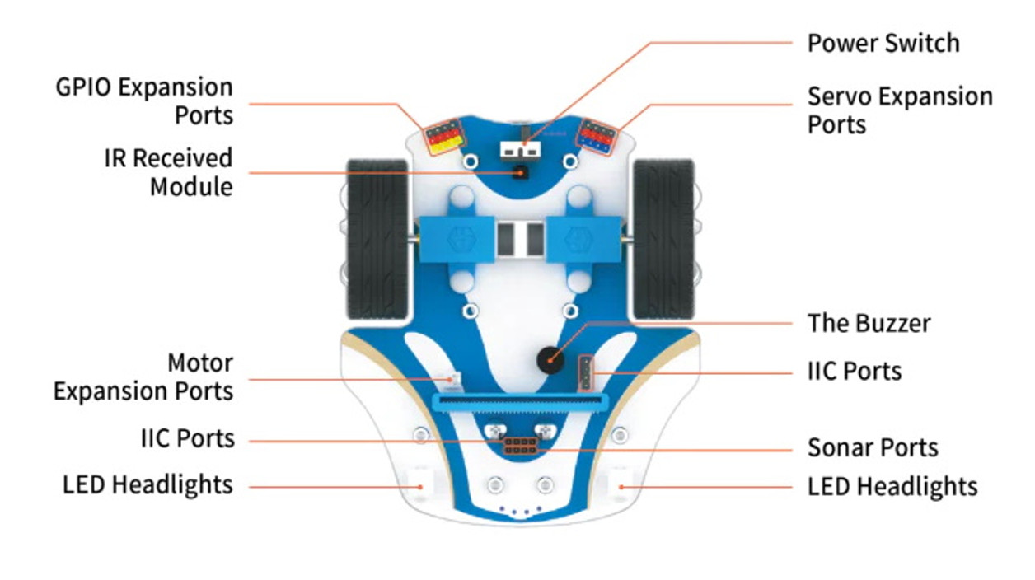
Ultrasonic Sensors
Ultrasonic is defined as "of or involving sound waves with a frequency above the upper limit of human hearing"
An ultrasonic sensor is an instrument that measures the distance to an object using ultrasonic sound waves
Look like the "eyes" of the CuteBot
Check if ultrasensor is in the correct port (Sonar Port/SR04)
In makecode, use this green block -->

Slide 5
Autonomous Obstacle Avoidance
Code the CuteBot to avoid the obstacles automatically to move forward
It should go straight until an obstacle is detected.
What should go under out On Start block?
How do we use the ultrasonic sensors in our code?
We will create a variable called Sonar
Variables --> Make a variable --> give variable a name (Sonar)
Use a set variable block to set the value stored in "Sonar"

Slide 6
Autonomous Obstacle Avoidance
We need to save the detected Cm value into our Sonar variable
If an obstacle is near the front of the CuteBot, the CuteBot should begin turning
How close should the obstacle be for the CuteBot to start turning?
Pick an appropriate range (Ex: 2cm to 20cm)
If the value of sonar is within this range, then the robot should course-correct
Else, the robot should continue moving forward

Slide 7
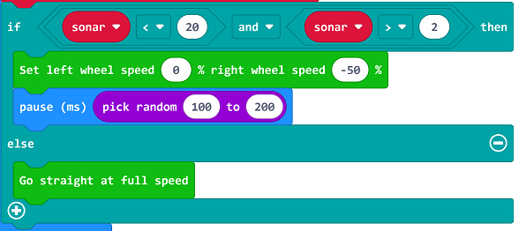
Autonomous Obstacle Avoidance
PiPi
Turn so that the CuteBot is facing a new direction
How often should we update our "sonar" variable and check this if-else statement?

Slide 8
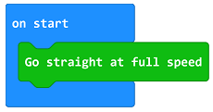
Autonomous Obstacle Avoidance – Solution
REMIX: Tinker with the numbers and observe the affect

Slide 9
Car Following with a Fixed Distance
Program the CuteBot to move with a fixed distance between the car and your hands
Set the Sonar variable in the forever block as in the previous exercise
If the detected value is between 5 and 10 , the car stops moving
If the detected value is below 5, the car reverses because of the short distance with the hands
If not any, the car moves forward to catch up with the hands because of the far distance with the hands and then stay still
Tip: use lower wheel speeds to make testing easier

Slide 10
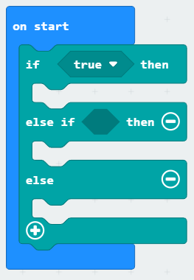
Car Following with a Fixed Distance
Using an if - else if - else block
Click the "+" on the if block to add additional "else if" conditions and outcomes
Click the "-" on the if block to remove a condition and outcome
Condition 1
Outcome 1
Condition 2
Outcome 2
Outcome 3
(Default if conditions 1 and 2 are not met

Slide 11
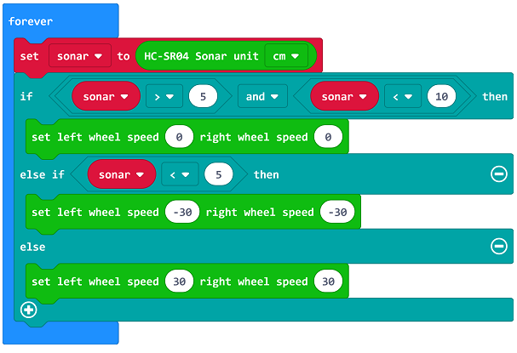
Car Following with a Fixed Distance -- Solution
RESULT: The CuteBot Shuld adjust itself to follow at a fixed distance

Slide 12
Car Following with a Fixed Distance
Keep your hand in front of the robot to make it move backwards
Expand upon this program
Try adding different behaviours for different ultrasonic sensor reading
Examples:
Green light when going forward and orange light when going backwards
Faster wheel speed when hand is far away and slow down as hand gets closer
Etc.

Slide 13
Challenge 1: Train of CuteBots
Create a train of CuteBots following each other
Work in groups of 3 to 4
Have a happy face when they join a train (using Micro:Bit display)
Have a sad face when there is no one to follow
What should happen if the CuteBot in front of you stops?
What should happen if the CuteBot in front of you speeds up?
What should happen if the CuteBot in front of you reverses?
Have the front of the train randomly speed up, slow down, and stop and program the rest of the robots to respond appropriately

Slide 14
Challenge 2: Rainbow Lights
Have the CuteBot change the colors of its LED lights as it gets closer to an obstacle (or as you move your hand closer to the robot)
Must use at least 6 different colors
Quickly alternate colors to create a fun affect
Use different colors for different sonar ranges, so that you are able to show all the colors

Slide 15
SHOWCASE!!
Show off your projects to the rest of class!
You may share your group's Train of Cutebots OR your Rainbow Lights

Slide 16
Q&A
What are ultrasonic sensors?
How can we use them with our CuteBots?
How can they be used more generally in robotics?
What are some real world examples of ultrasonic sensors?
Notes:
ultrasonic sensor is an instrument that measures the distance to an object using ultrasonic sound waves
Obstacle detection and avoidance
It is an alternative to technical vision (should work in the dark). Allows robots to better perceive their surroundings
Collision avoidance, People detection for counting, vehicle detection for carwash, etc.

