Slide 1
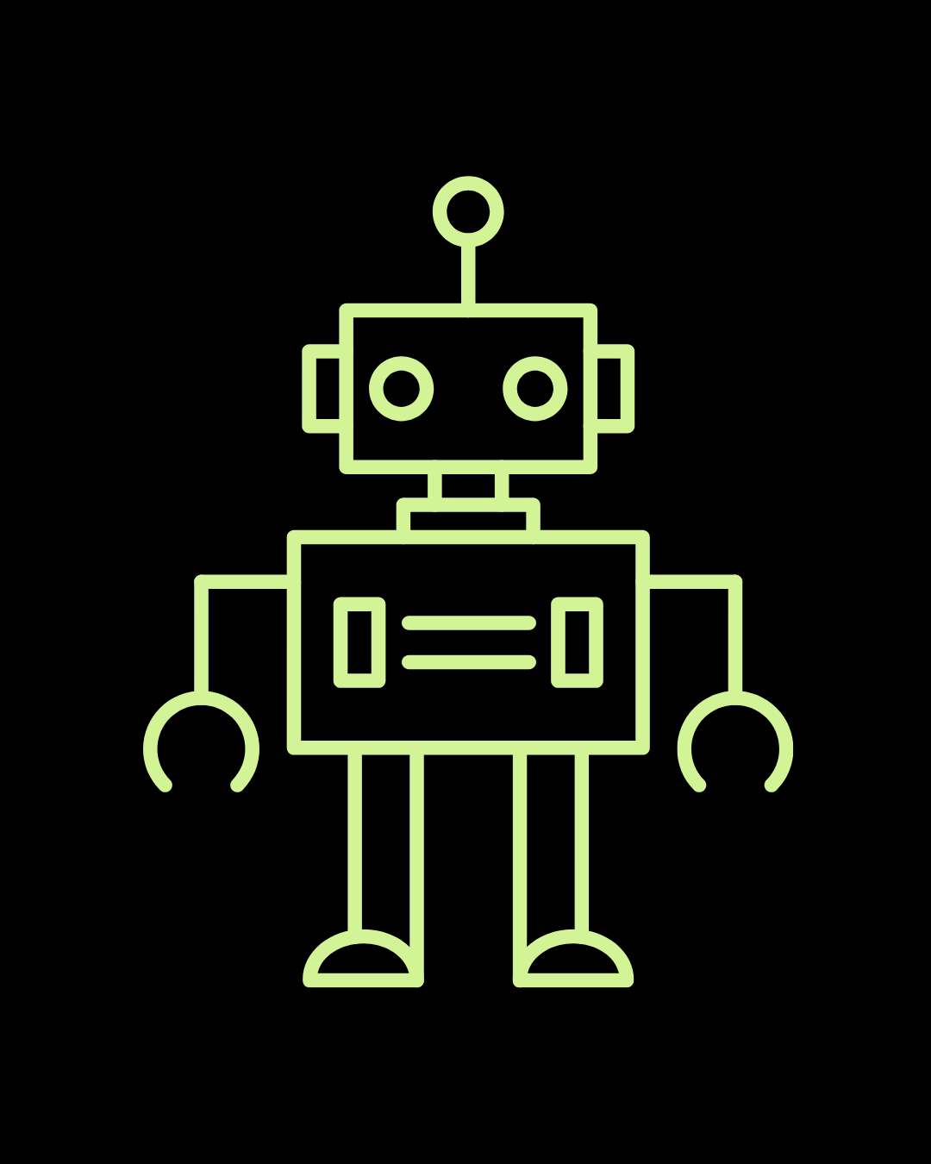
Lesson 4: Recap Lesson

Slide 2
Review
What are some features on the Micro:bit?
What sensors does the Cutebot add?
What does RGB stand for? What numbers would I use to get Red? Green? Purple?
Where are the sensors that the Cutebot uses to track lines?

Slide 3
CuteBot Rules:
If you break any of these rules, you can choose:
Only run bots on designated mats
Limit speed to < 75% (unless otherwise specified)
Unplug batteries when not in use
Do not drop the CuteBots
Do 3 burpees
Sing "I'm a Little Teapot" song
Do 10 jumping jacks
Notes:
CuteBot and Construction Expectations +

Slide 4
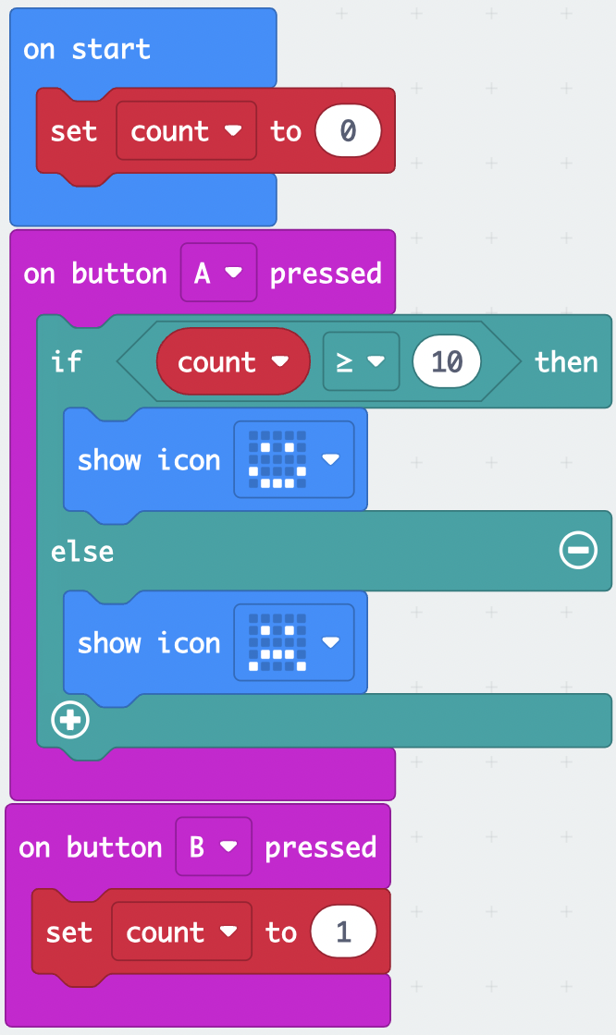
Debug Challenge #1
This program should set a variable called count to zero and add one to it every time the B button is pressed. When the A button is pressed, if count is bigger than 10, I should see a smiley face. Otherwise, I should see a frowny face.
No matter what I do, I only see the frowny face! Can you fix it?
Notes:
Debug: https://makecode.microbit.org/_PzacsiCmP9Lw
Solution: https://makecode.microbit.org/_C5yetYHpmUYb

Slide 5
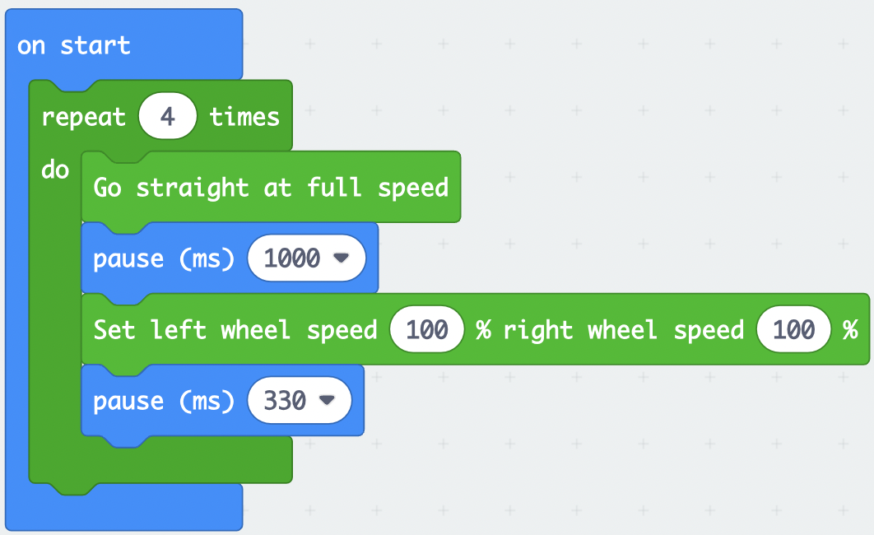
Debug Challenge #2
When I download this program, my Cutebot should move in a square pattern
Does it work? What's wrong with it?
How can I fix it?
Notes:
Debug: https://makecode.microbit.org/_5YyAYxhHh3bM
Solution: https://makecode.microbit.org/_Wjy6dD40mYJp

Slide 6
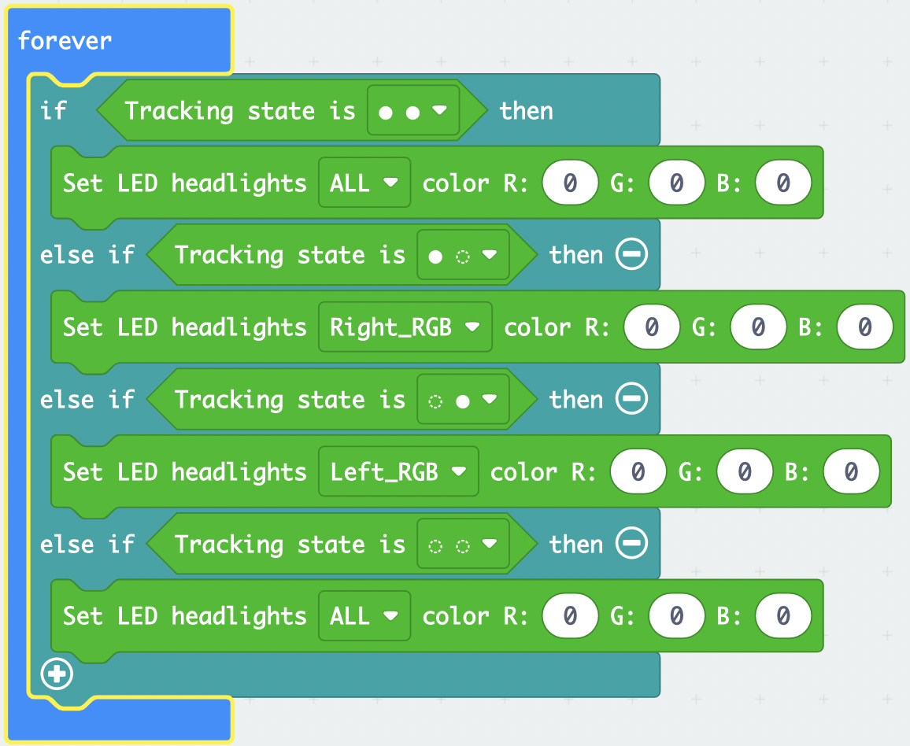
Debug Challenge #3
This code is almost done
What numbers would I put if:
When both sensors are not covered, both lights are white
When the right sensor is covered, the right light is blue
When the left sensor is covered, the left light is yellow
When both sensors are covered, both lights turn red
Notes:
Debug: https://makecode.microbit.org/_4gp7JFE5sDTA
Solution: https://makecode.microbit.org/_7wPPugdJ8eKM

Slide 7
Putting it Together
We now have all the tools we need to help our Cutebot navigate a maze
Using our line sensor to stay within the maze, we want to reach the end as fast as we can
Use the different features we talked about!
How can you use the RGB LEDs in this project?
What ways can you make sure the Cutebot stays in the maze?

Slide 8
Rules
Work in teams of 1-2
Use as many of the Micro:Bit and Cutebot features you can
How could you use the LED screen? The microphone/speaker?
RGB LEDs?
Go for the fastest time!

Slide 9
Troubleshooting & Discussion
What were some problems that came up? How did you solve them?
Are there examples in the real world that use the same sensors and features we used today?
Ideas on how we could make our programs better?
Notes:
Possible Problems: Didn't back up before turning, turning too fast/too slow
Examples: Self Driving cars need to stay in their lanes! If they are following a GPS, need to make sure they stay on that path.
Factory Robots may need to do their task only if they see something with their line sensor
Improvements: A way to detect turns sooner... by distance... using an ultrasonic sensor! (next class)

