Slide 1
Lesson 3: Sensors and Data Collection

Slide 2
CuteBots Review
We learned how to write programs to move our CuteBots
We can move forwards, backwards, and turn left and right
We can change the speed of each wheel
We can make patterns and write a program for our CuteBots to dance

Slide 3
CuteBot Rules:
If you break any of these rules, you can choose:
Only run bots on designated mats
Limit speed to < 75% (unless otherwise specified)
Unplug batteries when not in use
Do not drop the CuteBots
Do 3 burpees
Sing "I'm a Little Teapot" song
Do 10 jumping jacks
Notes:
CuteBot and Construction Expectations +

Slide 4
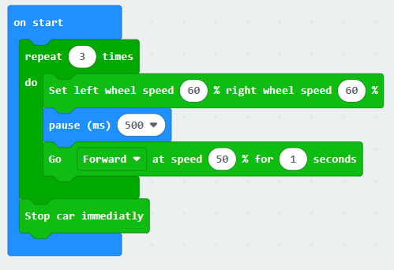
DEBUG
We want the CuteBot to drive in a TRIANGLE shape, but it is not working as intended. What might we need to change in our code?
Notes:
SOLUTION:
Change right wheel speed to 0%

Slide 5
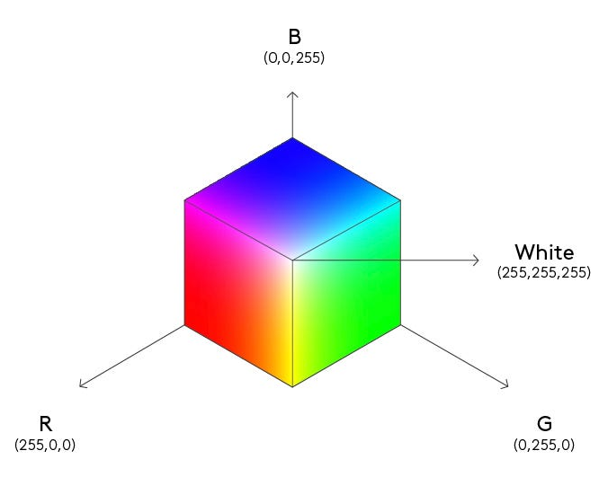
LED and RGB
Light-Emitting Diode
Red-Green-Blue
An RGB light changes the output inside every single one of its diodes to "mix" your desired color using red, green, and blue as base colors
Where do we see these lights in the real world?
Notes:
Image from https://medium.com/lightricks-tech-blog/an-intro-to-color-spaces-and-how-i-used-them-for-my-game-f712153b114
Answer to question:
lamps, traffic lights, RGB keyboards, etc

Slide 6
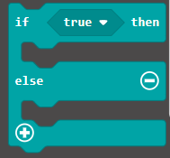
Challenge: Automatic Headlights
We will program our CuteBot to turn on its headlights automatically in the darkness (use https://makecode.microbit.org)
How can we detect darkness?
How can we tell the CuteBot to turn on its lights only when it is dark?
Try writing a code yourself. (Solution on next slide)
Notes:
Light

Slide 7
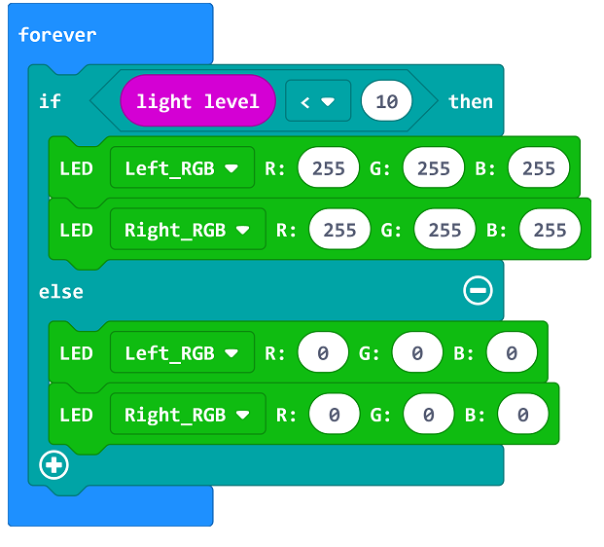
Automatic Headlights
Why forever loop?
What happens if we change the value in the "light level < 10" statement?
What does R:255, G:255, B:255 mean?
What does R:0, G:0, B:0 mean?

Slide 8
Changing the values for RGB
How can we make different colors?
What color is this?
What color is this?

Slide 9
Sensors
Sensors "measure the environment"
Different kinds of sensors: temperature sensor, light sensor, speed sensor, etc.
What type of sensing did we use in the Automatic Highlights exercise?
What kind of sensors do we interact with in the real world?
Ex: thermometer, photo-radar for speeding tickets, etc.

Slide 10
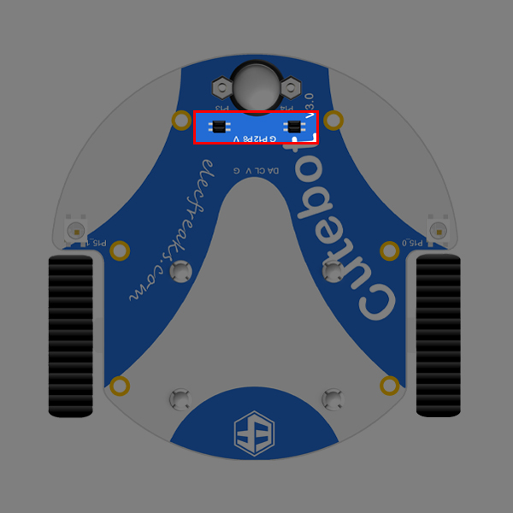
CuteBot Sensors
The CuteBot has two line-tracking probes connecting to P13&P14 on the Micro:Bit
These are used to detect the black line and its edges.
Why might we want to detect black lines/edges?

Slide 11
Challenge: Run Along the Black Line
Goal: program our CuteBots to drive along a smooth black line
The CuteBot may not be able to detect sudden sharp turns
There are four statuses for the line tracking sensors:
○● left probe doesn't detect black line, while the right probe does.
●○ left probe detects black line, while right probe does not
●● both probes detect the black line
○○ neither probe detects the black line
REMIX: experiment with the code. Try running your code on different tracks.

Slide 12
Challenge: Run Along the Black Line
For this challenge we consider 3 situations: ○●, ●○, and ●●
We will use 3 if statements!
If ○● (only right probe detects black line), what should we do?
Line is slightly to the right of robot
If ●○ (only left probe detects black line), what should we do?
Line is slightly to the left of robot
If ●● (both probes currently detect black line), what should we do?
Robot is currently on the line

Slide 13
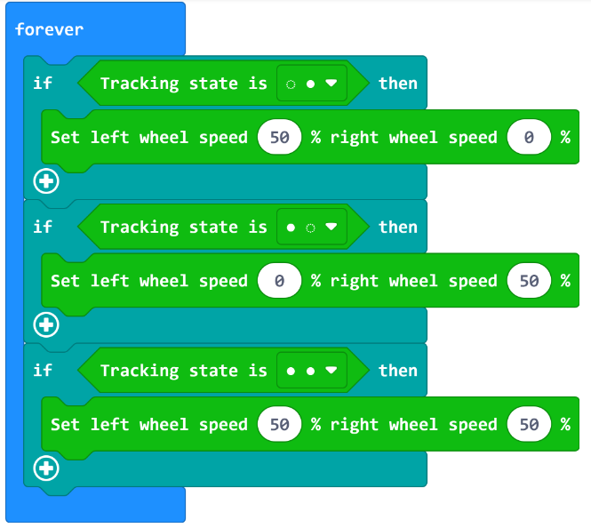
Challenge: Run Along the Black Line
Line is to the right, so we turn right
Line is to the left, so we turn left
Continue straight

Slide 14
Challenge1: Count Down and Go
Have your CuteBot change its LED lights from red to yellow to green, and then have it follow the black line.
Change lights back to red once it is finished moving
Add sound effects for start and stop

Slide 15
Challenge2: Stop and Start
While the lights are on, have your CuteBot follow the black line
When the room lights turn off, your CuteBot should turn on its headlights (use your favorite color) and wait
Once the room lights are turned back on, your CuteBot should turn off it's headlights and continue following the black line

Slide 16
Q&A
What does RGB stand for?
What does LED stand for?
How can we get the color yellow with RGB values?
What kinds of sensors are there? Which ones do our CuteBots have?
What are some real-world applications of these sensors?
Notes:
Red Green Blue
Light-emitting diode
252, 252, 0
Light sensors, Sound sensors, temperature sensors, movement sensors, etc.

