Slide 1
Lesson 2: Introduction to Cutebots

Slide 2
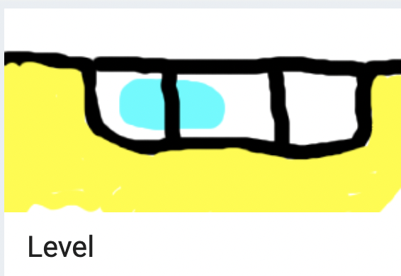
What Did We Learn Last Class?
What are Micro:Bits? What can they do?
Let's try a tutorial using the accelerometer:

Slide 3
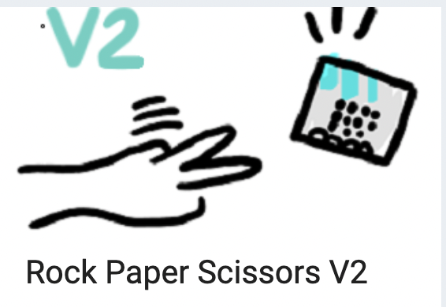
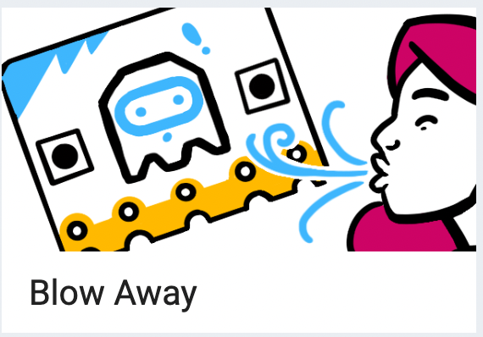
Warmup Tutorials
Some more tutorials to get warmed up

Slide 4
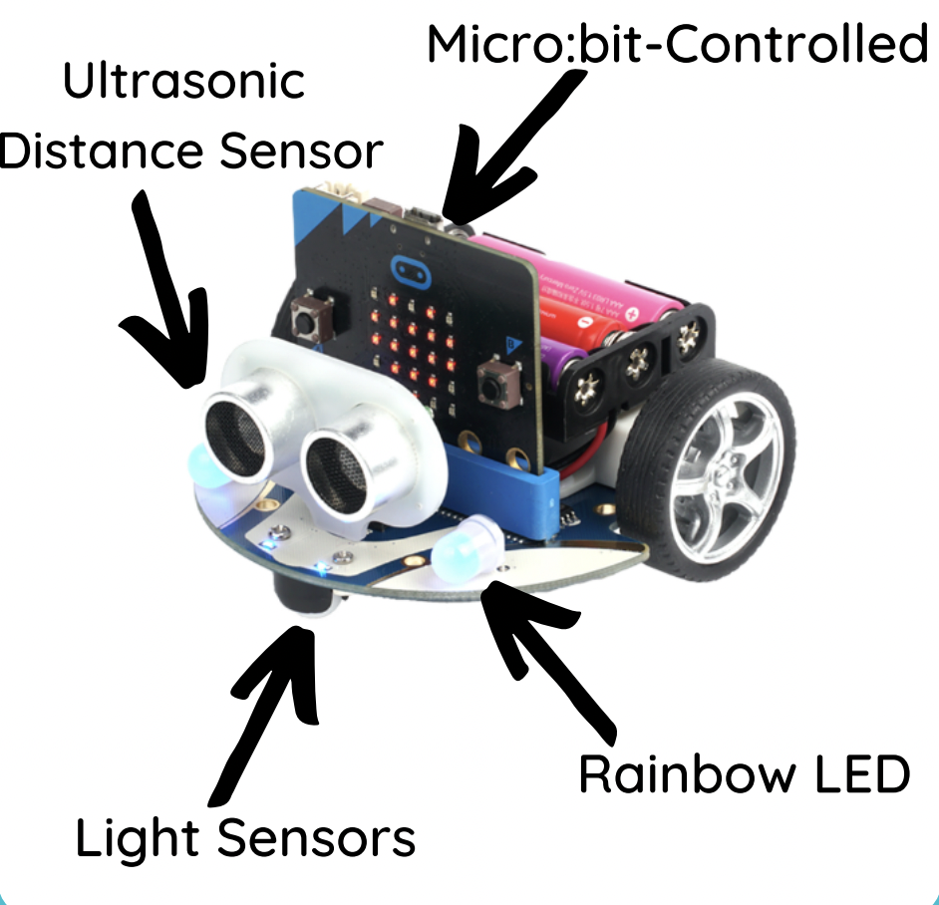
Intro to Cutebots
We can give our Micro:Bits a body to let it do more things
These are called Cutebots
Cutebots have some extra sensors, lights and wheels!
We'll talk more about the sensors and lights another day

Slide 5
CuteBot - Rules
Cutebots are very fragile so we need to be careful with them
We will not have any food or drinks near them
We will first code our Micro:Bits outside of the Cutebot, then plug it into the Cutebot gently
While they are moving, we will not block their movement for a long time
Do not bend any of the pins for the servo or the ultrasonic sensor (the eyes)

Slide 6
CuteBot Rules:
If you break any of these rules, you can choose:
Only run bots on designated mats
Limit speed to < 75% (unless otherwise specified)
Unplug batteries when not in use
Do not drop the CuteBots
Do 3 burpees
Sing "I'm a Little Teapot" song
Do 10 jumping jacks
Notes:
CuteBot and Construction Expectations +

Slide 7
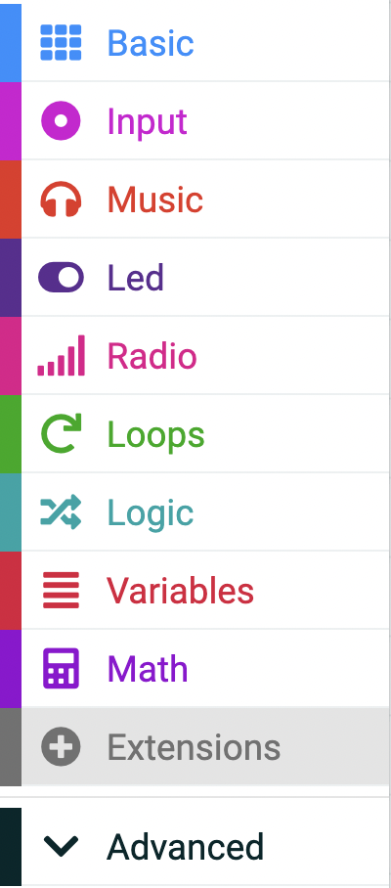
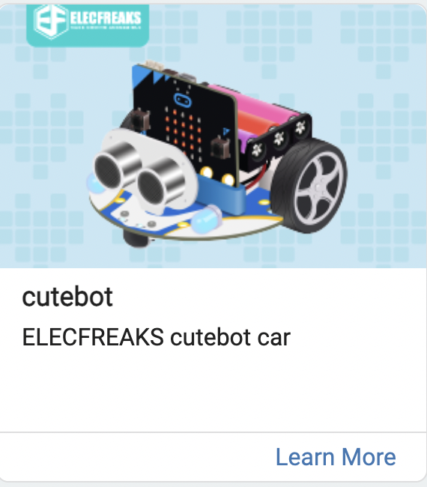
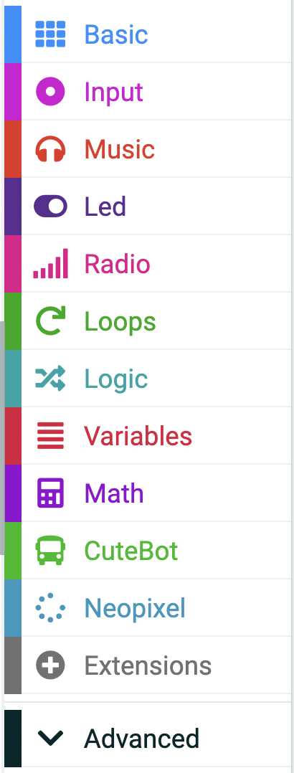
First Cutebot Program
We are going to create our first program for our Cutebot
First we need to add the extension in makecode.microbit.org

Slide 8
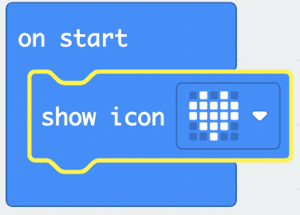
Making it Move
Lets start by making our Cutebot move forward and backwards:
Download and test our code!
All of our old code for the regular Micro:Bit can be used to make it more exciting!

Slide 9
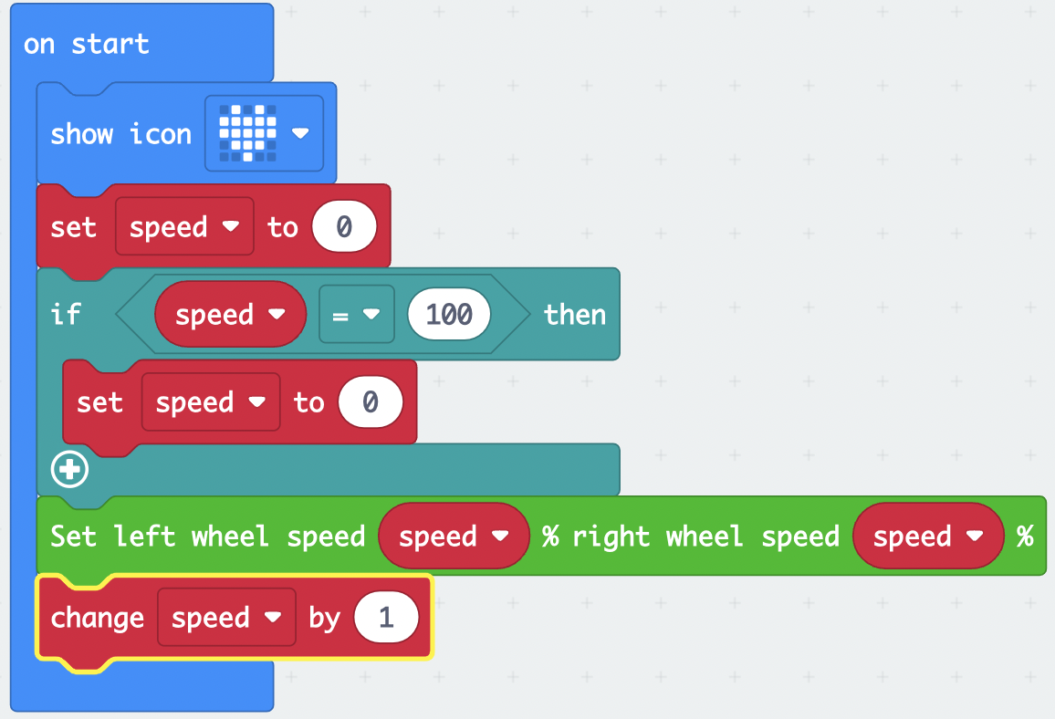
More Practice
What do you think the program will do?
Try re-creating it
What happens if I change the 100 to a 50?
How can I make it start really fast and gradually get slower?
Notes:
Set speed to 100 at the start and have it change by –1. Change the if statement to check if speed = 0, set speed to 100

Slide 10
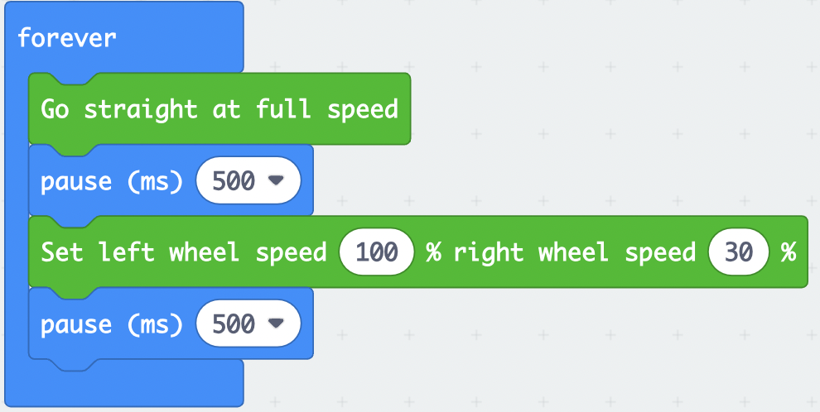
Turning
What do you think the program will do?
Try re-creating it
How would we make it turn the other way?

Slide 11
Make it Dance!
Let’s try making our Cutebot car move in a figure-eight pattern
Try making it on your own first or while working with a friend
How fast should your Cutebot go? How long should it be turning for? How much should it be turning?

Slide 12
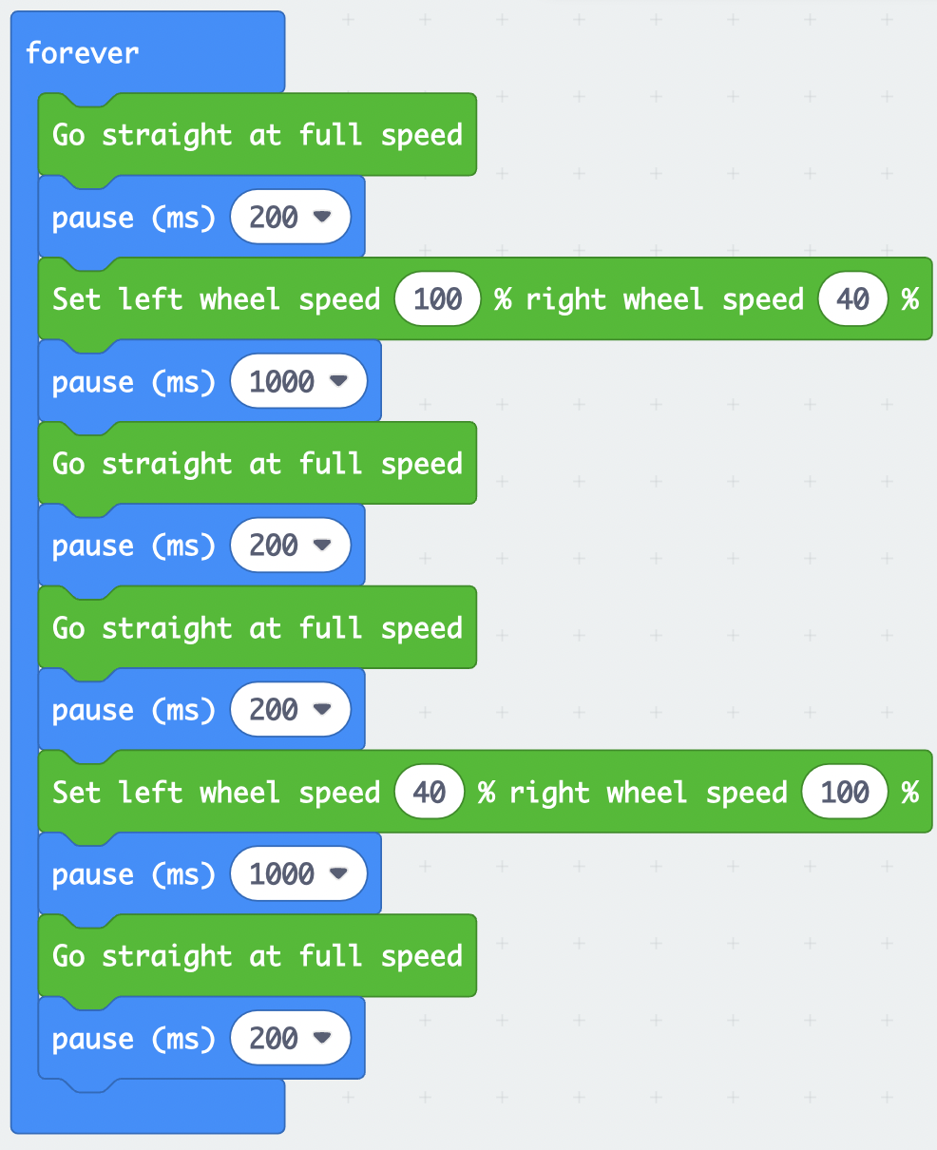
One Solution
Here's one way to make our Cutebot go in a figure-eight pattern:

Slide 13
Your Turn
Use what we've learned so far to make your Cutebot do a unique dance
Make it more exciting!
Add an animation to the LED screen while it dances
Make it play music
Try having it react to sound

