Slide 1
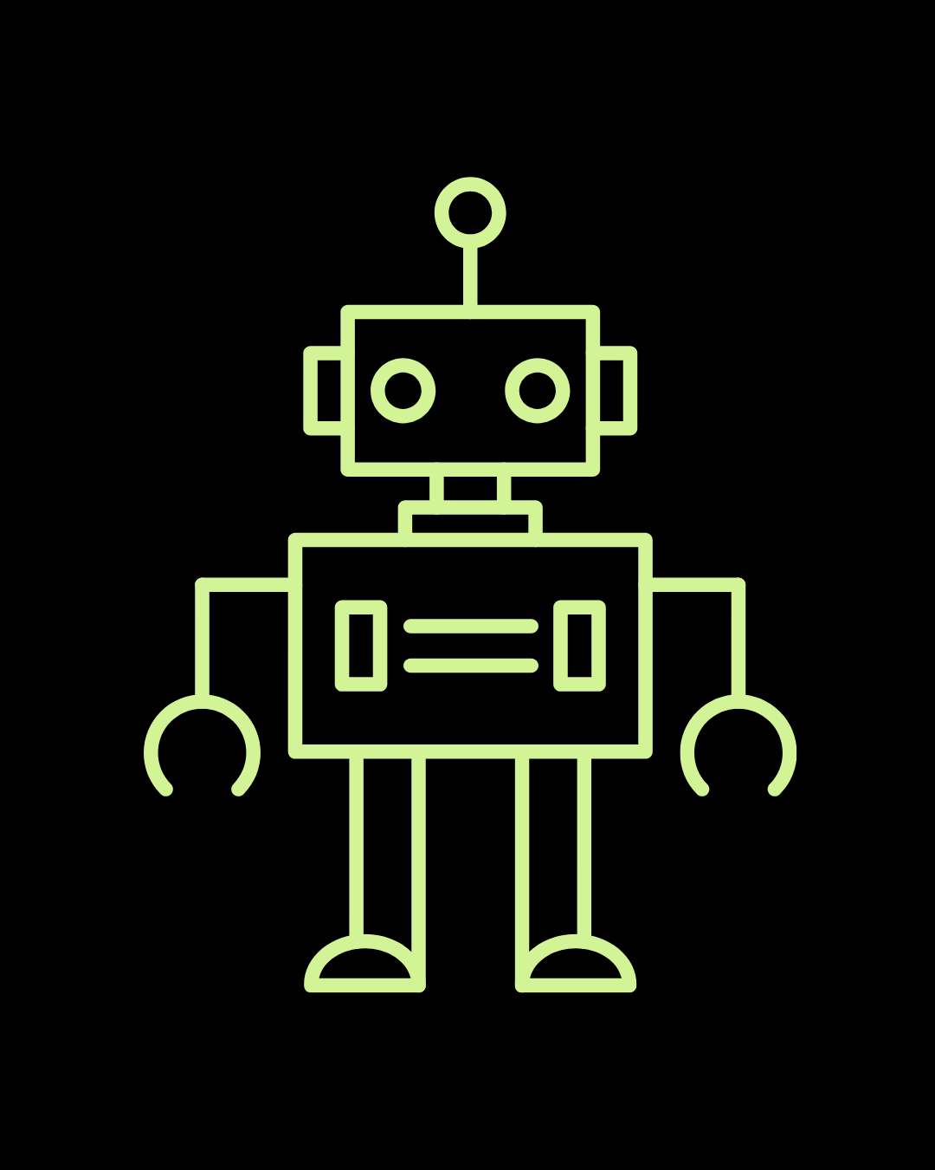
Lesson1: Introduction to Robotics and MicroBits

Slide 2
Course Overview
Lesson 1: Introduction to Robotics and MicroBits
Lesson 2: Introduction to Cutebots and Basic Movement
Lesson 3: Sensors and Data Collection
Lesson 4: Project
Lesson 5: Obstacle Avoidance
Lesson 6: Radio signals and remote control
Lesson 7: Servo Motor Control
Lesson 8: Integrating Multiple Behaviors
Lesson 9-10: Mini-Hackathon

Slide 3
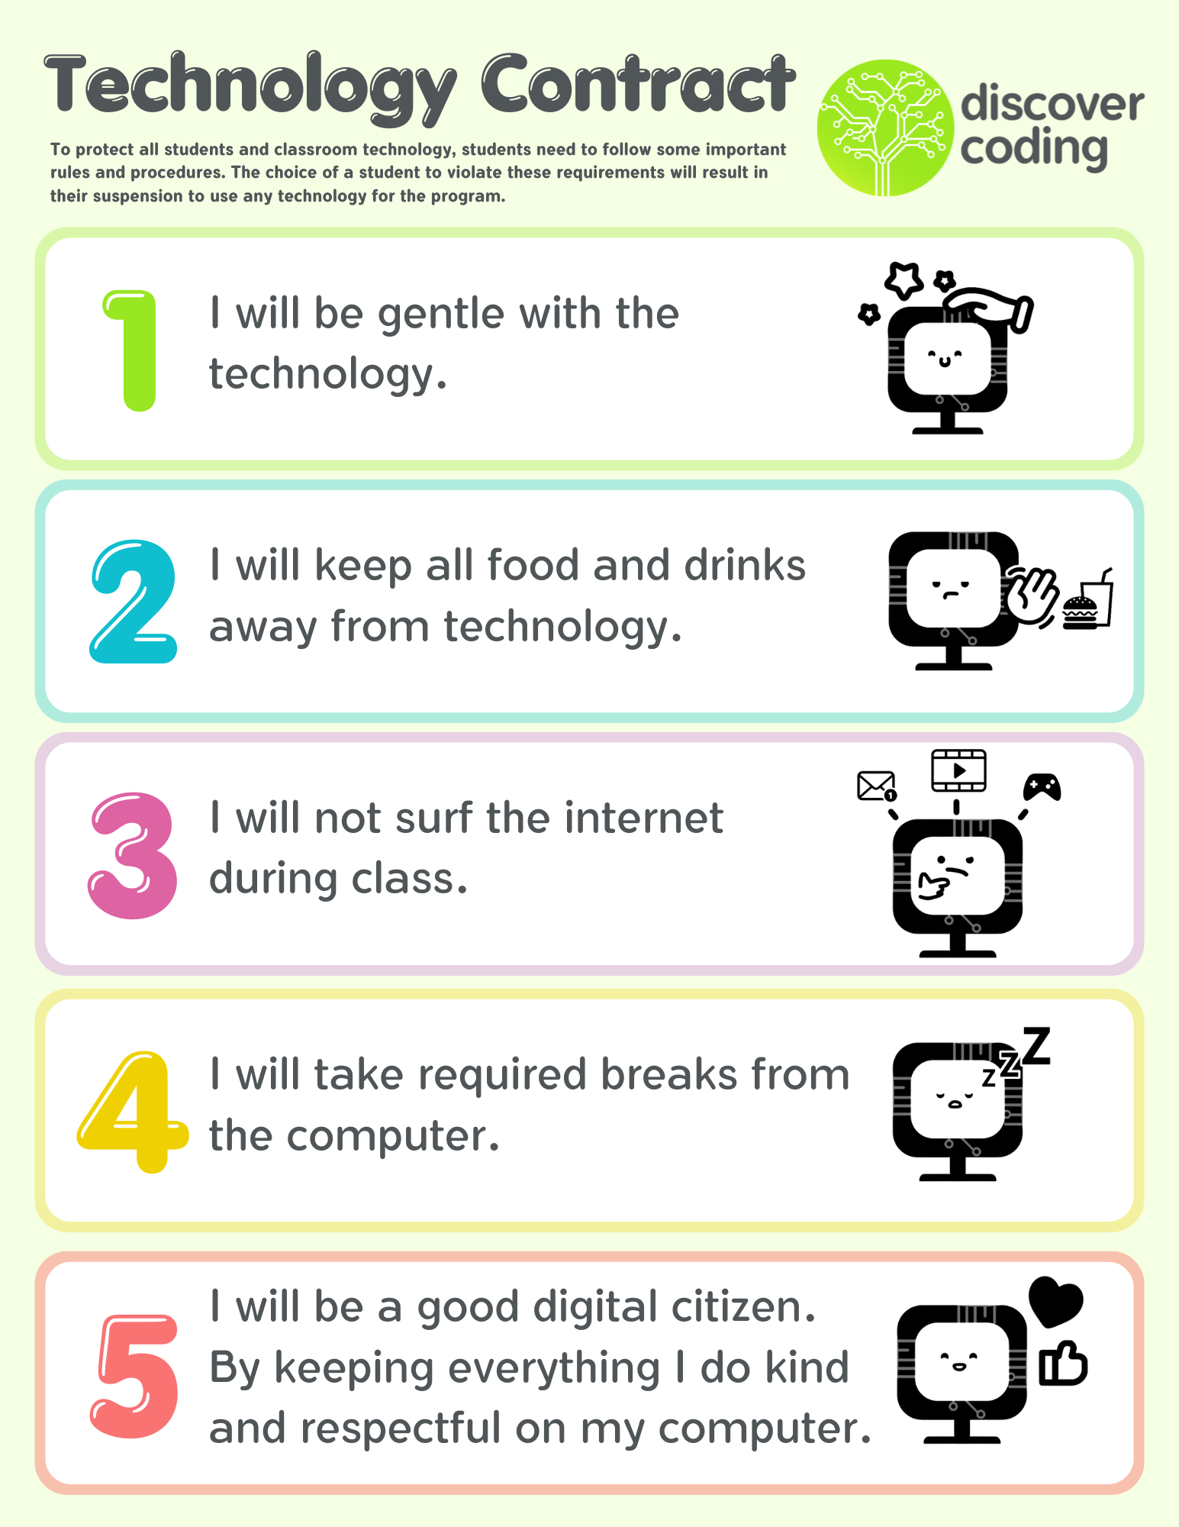

Slide 4
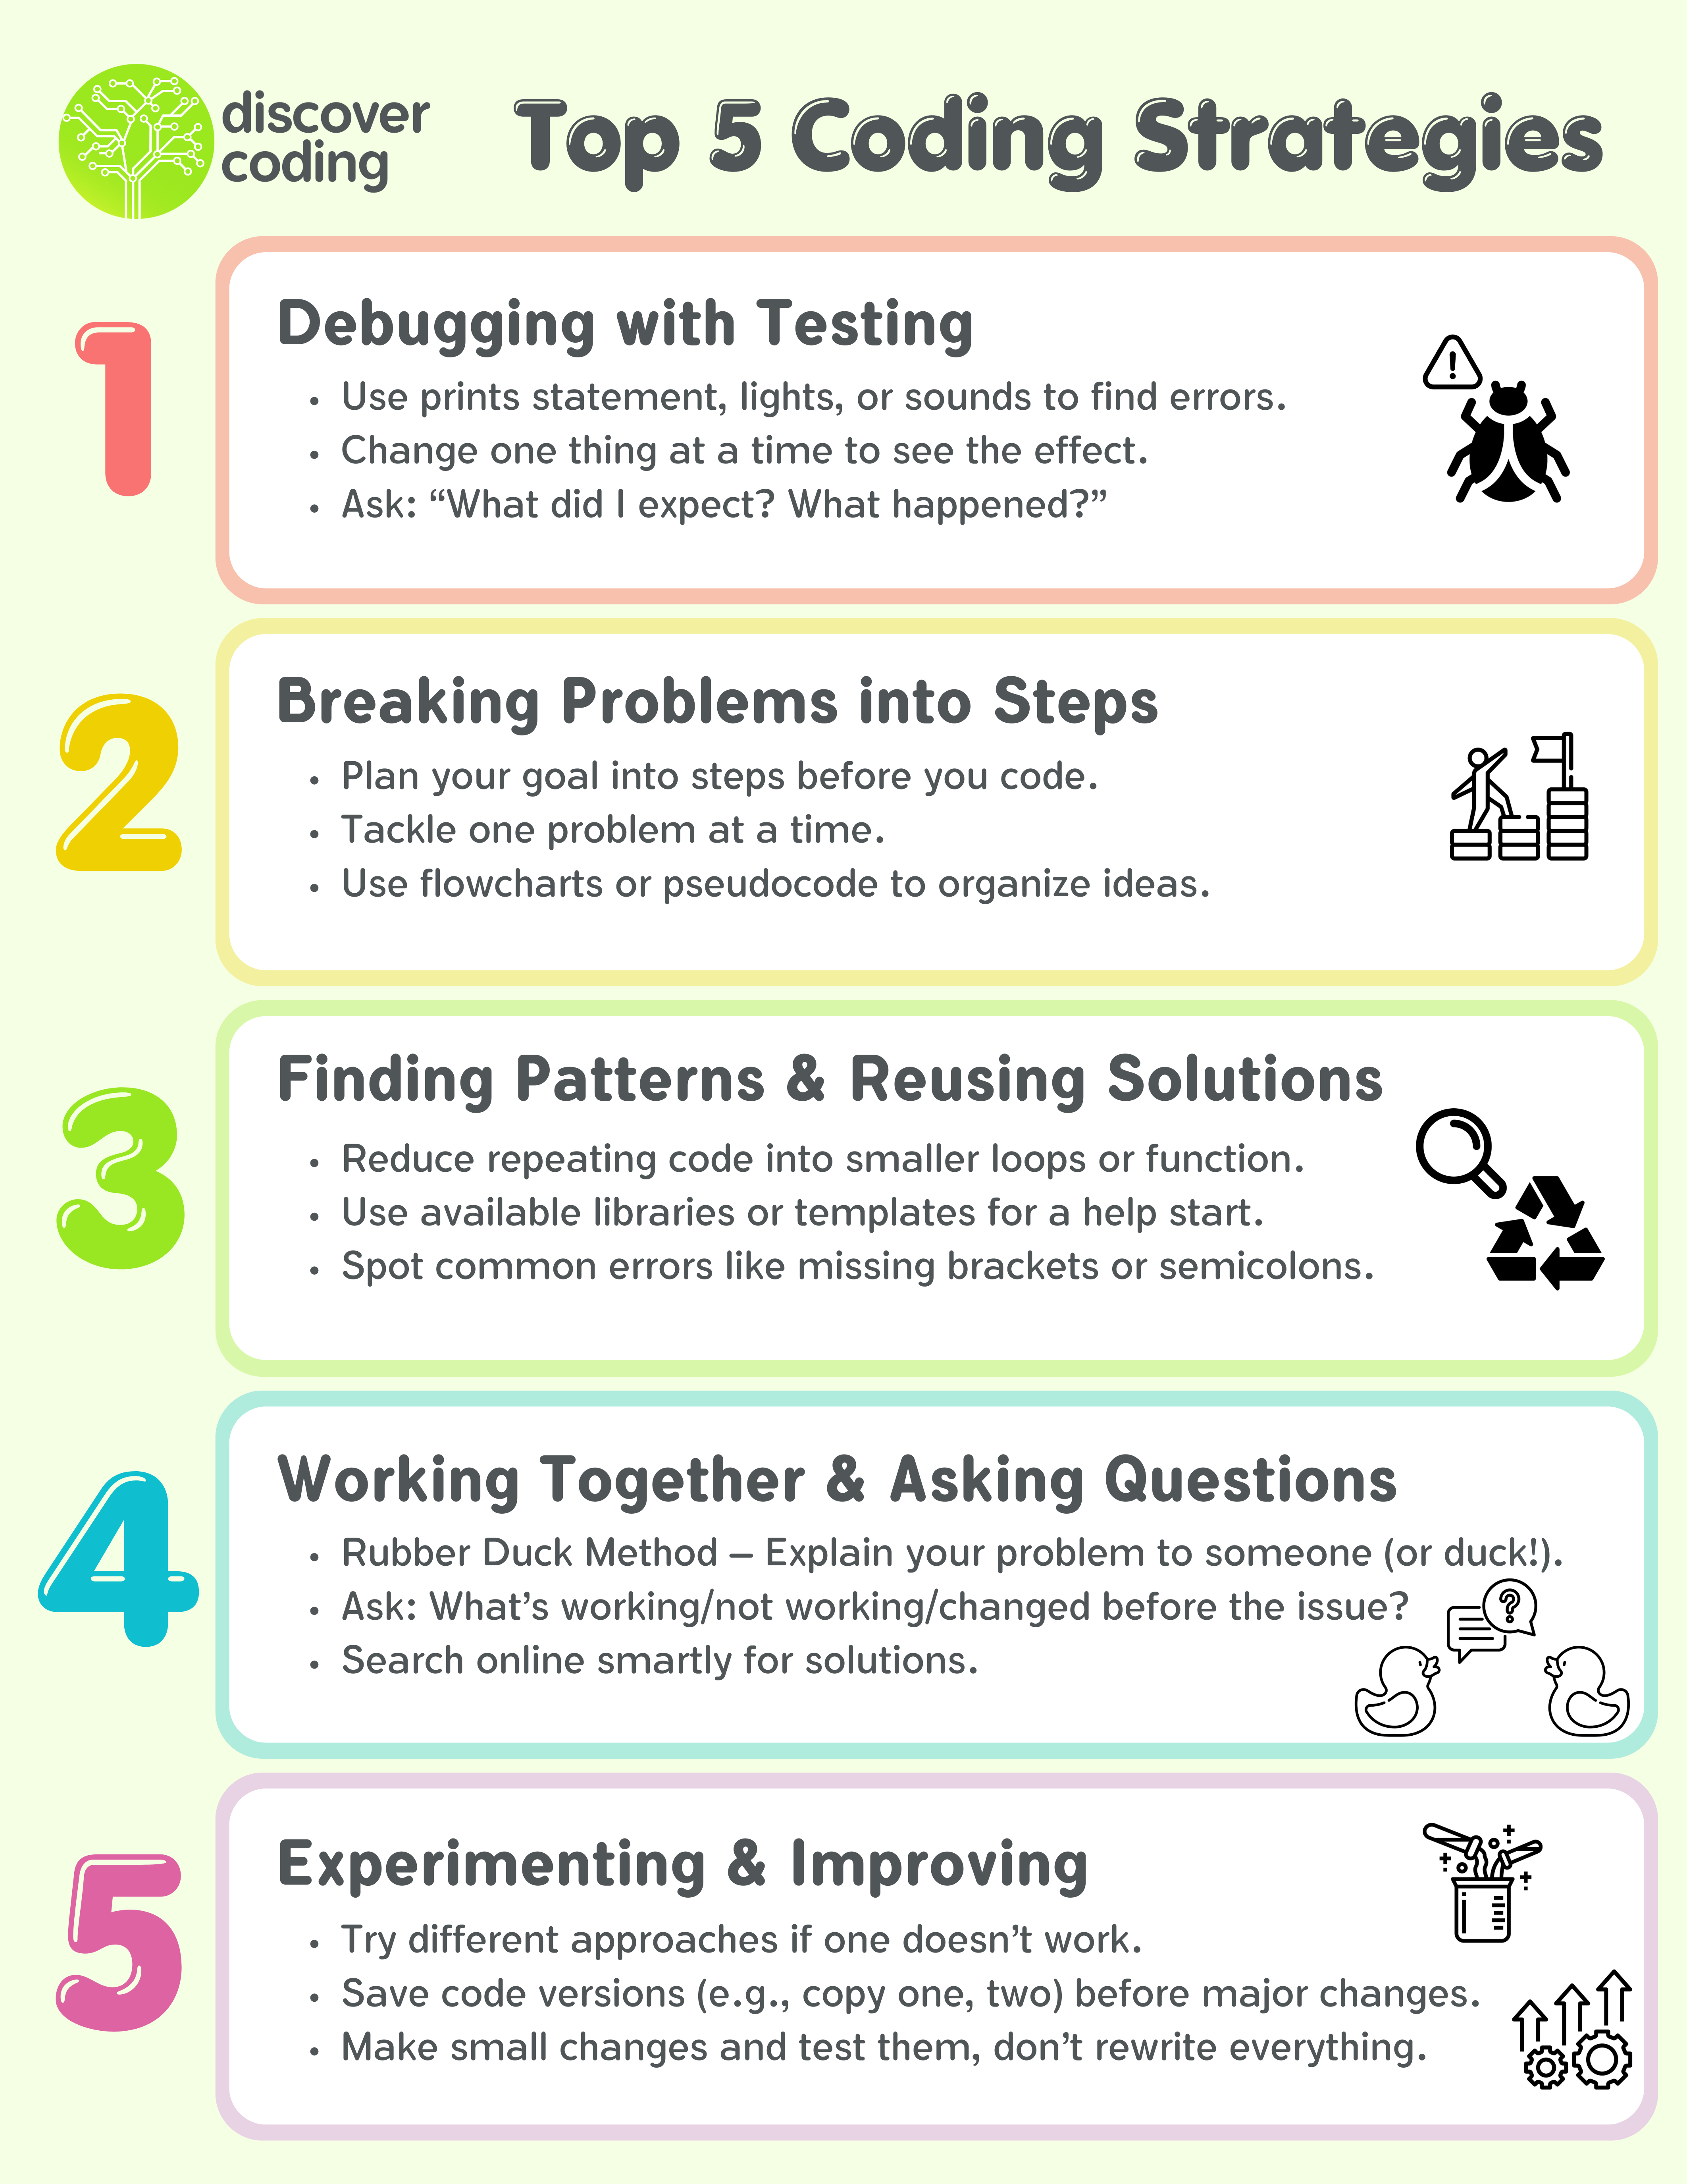

Slide 5
Learning Objectives
Understand the basic principles of robotics and how they apply to real-world scenarios.
Demonstrate proficiency in using MicroBits and Cutebots for various robotic applications.
Develop and execute programs that control the movement and behavior of robots.
Integrate sensor data to enable robots to interact with their environment.
Code and utilize servos for precise control of robotic components.
Apply problem-solving and critical thinking skills to troubleshoot and refine robotic programs.
Collaborate effectively in teams to complete robotics challenges and projects.
Communicate their ideas and solutions effectively through presentations and demonstrations.

Slide 6
Introduction to MicroBits
https://www.youtube.com/watch?v=u2u7UJSRuko
The first MicroBit was created in 2015
It is a pocket-sized computer that can be programmed in many ways
Notes:
Information from https://www.bbc.co.uk/teach/microbit/articles/zfjg8p3#:~:text=The%20micro%3Abit%20is%20a,explore%20ideas%20using%20real%20code.

Slide 7
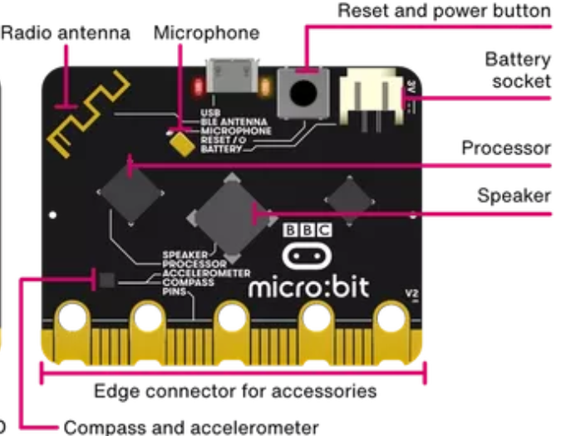
MicroBit Components
Notes:
Image from https://microbit.org/get-started/features/overview/

Slide 8
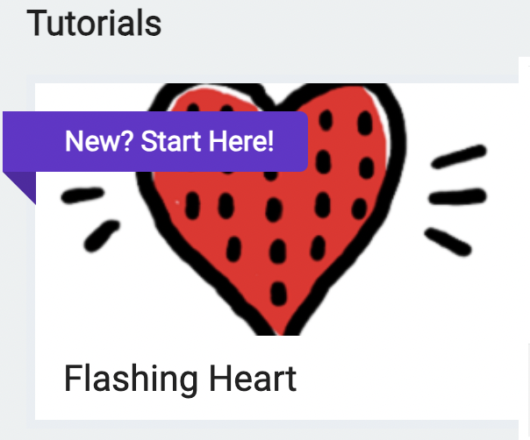
Our First Program
We're going to write our very first Micro:Bit program!
Go to makecode.microbit.org and look for the Flashing Heart Tutorial
Do not plug in your Micro:Bit yet and follow along!

Slide 9
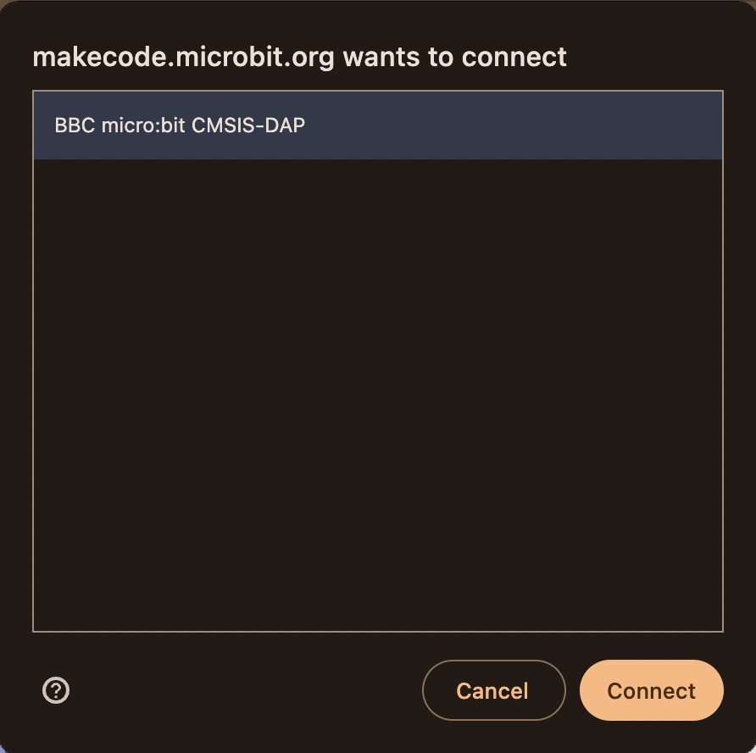
Downloading our Program
Now that we finished writing our code, we can download it onto the Micro:Bit
Connect your Micro:bit to your computer using the USB cable

Slide 10
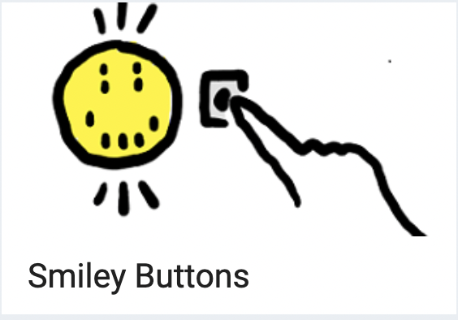
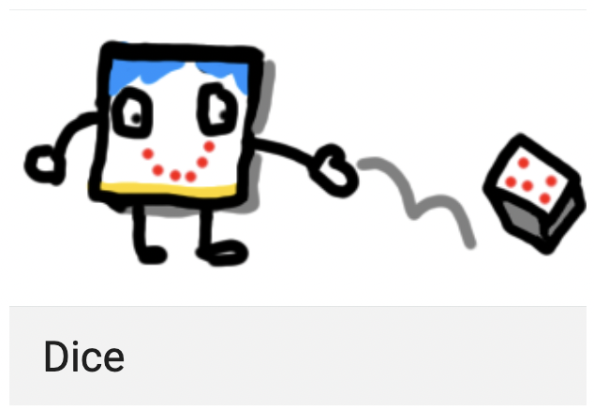
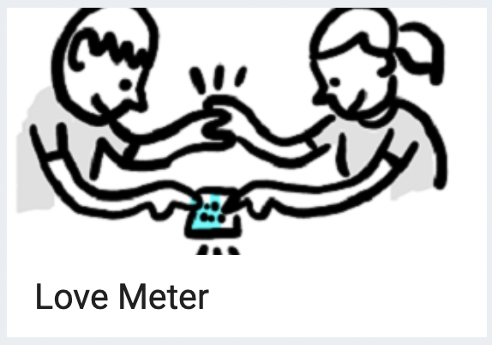
More Tutorials!
Congratulations! You made your first Micro:Bit program!
Some tutorials to get even more familiar with Micro:Bits
1.
2.
3.

Slide 11
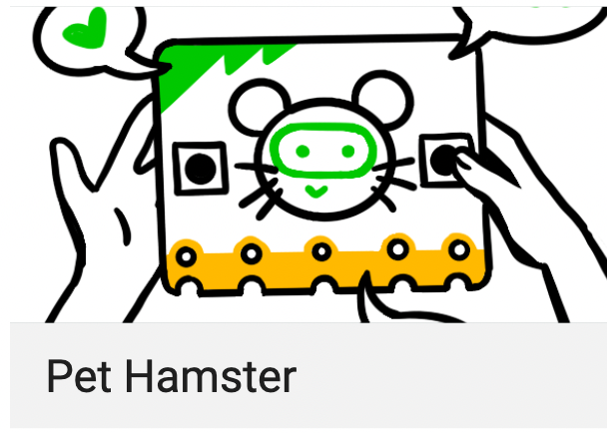
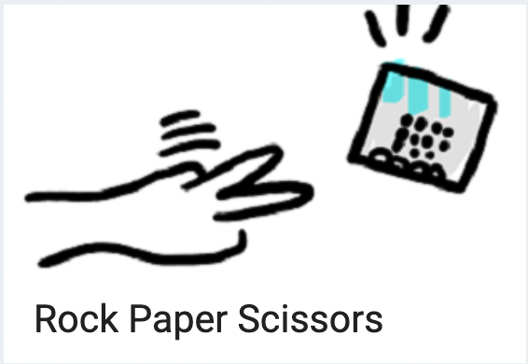
Even More Tutorials!
4.
5.
6.

Slide 12
Applications to our World
We learned a lot about what Micro:Bits can do
What are some of the features on our Micro:Bits?
Where are some of these features used in other devices in our world?
How can we apply what learned to robots?
Notes:
Features: Buttons, Microphone, Speaker, LED screen, logo-button, accelerometer (detects movement)
Buttons are used in keyboard, controllers, cars EVERYWHERE! Microphones in our phones/computers, Our computers have screens (made up of MUCH smaller leds)
The button used in the logo uses the same ideas as touch screens! Accelerometers are used anywhere we need to detect movement (alarm system)
Some robots might needs buttons on a controller to control what they do. They could also use microphones to recognize sounds/speech and do an action. We could give them screens to show an animation or give them a face.

