Slide 1
Extra Robotic Hackathon Challenges

Slide 2
CuteBot Rules:
If you break any of these rules, you can choose:
Only run bots on designated mats
Limit speed to < 75% (unless otherwise specified)
Unplug batteries when not in use
Do not drop the CuteBots
Do 3 burpees
Sing "I'm a Little Teapot" song
Do 10 jumping jacks
Notes:
CuteBot and Construction Expectations +

Slide 3
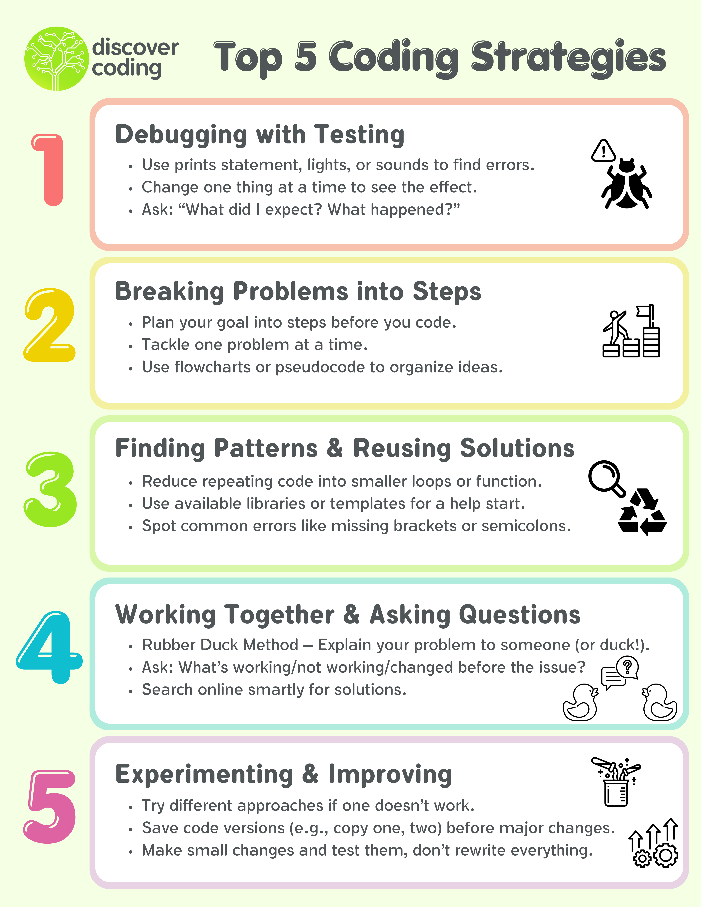
Notes:
CuteBot and Construction Expectations +

Slide 4
Hackathon: Knock Over
Program CuteBot to knock over your opponent's ball first.
In this player vs player game, each player has a ball on a cup and the goal is to knock the opponent's ball off their cup to win.
How can you use Cutebot/Micro:Bit features to aggressively navigate toward the ball or defensively protect your own ball?
Notes:
MATERIALS YOU WILL NEED FOR THIS:
pipecleaners/popsicle sticks
Two cups, two balls
Encourage students to use remote controls (two microbits using radio signal) for their cutebots.
Another challenge would to be do this hackathon with only one microbit (using sensors for navigation).
Ensure each players ball on cup is NOT easily knocked over by making the cutebot go forward towards the opponents cup.
One suggestion is to make players ball on the cup diagonal from one another so it is more challenging for the players
Encourage students to add additional attachments (servo arms/pipecleaners/popsicle sticks) to help them with this challenge.
Sometimes students may need to reset their cutebot during a match, allow them to reset their cutebot BUT they are only allowed to place them at a starting point.

Slide 5
Hackathon: To the Drawing Board!
Program CuteBot to create a drawing using a marker.
Each Cutebot must create shapes, patterns, or a drawing using a marker — get creative!
What creative movements can you program your Cutebot to make your drawing stand out?
Notes:
MATERIALS YOU WILL NEED FOR THIS:
Pipe cleaners and popsicle sticks
Dry eraser markers
White boarders/surface to draw
Ensure the marker stays in contact with the surface when drawing (make sure to put the cap back on when not in use).
Students may use one microbit or two microbit (radio signals) for this challenge.
Incorporate award categories that instructors judge, so students can plan and work towards them.
Some example, Most Abstract, Best Storytelling, Best Movement, Most Creative Design etc.
Allocate time for students to showcase and explain their art masterpiece.

Slide 6
Hackathon: CuteBot Soccer
Program Cutebot to grab, pass, and score the ball.
In this player vs player game, each player will remotely control a Cutebot to play a game of soccer. First player to score wins!
How can you use Cutebot/Micro:Bit features to grab the ball to score or position defensively protect your own goal zone?
Notes:
MATERIALS YOU WILL NEED FOR THIS:
pipecleaners/popsicle sticks
Walls (Two walls for the mat)
1-2 Balls that can be grabbed by a servos
Encourage students to use remote controls (two microbits using radio signal) for their cutebots.
If students are struggling to score points, make the nets bigger
If mat is too small, limit the amout of attachments students can add to their bots
Encourage students to add additional attachments (servo arms/pipecleaners/popsicle sticks) to help them with this challenge.
Sometimes students may need to reset their cutebot during a match, allow them to reset their cutebot BUT they are only allowed to place them at a starting point.

Slide 7
Hackathon: Dance Party
Program Cutebot to a dance-off. Include costumes, dance moves, and music!
Each Cutebot must have a costume, dance(s), and music — get creative!
How can you use Cutebot/Micro:Bit features to make your Cutebot unique?
Notes:
MATERIALS YOU WILL NEED FOR THIS:
Pipe cleaners and popsicle sticks, or other arts-n-craft material
Encourage all of the features of both Cutebot AND Micro:bit
Microbit LED/Sound
Cutebot LED headlight colors/Servo Arms
Give them space to be creative
Incorporate award categories that instructors judge, so students can plan and work towards them.
Some examples, Best Dressed, Best Choreography, Best Music, Most Features, etc.
Allow students showcase time for them to explain their cutebot's feature for the dance party (~3 minutes limit each)

Slide 8
Hackathon: Clear the Table
Program Cutebot to push all objects off a table.
The Cutebot that pushes most objects off the black boundary without leaving it the boundary within a time limit completes the challenge!
How can you use Cutebot/Micro:Bit features to navigate within the table's boundaries?
Notes:
MATERIALS YOU WILL NEED FOR THIS:
3-5 objects that a cutebot is able to push
pipecleaners/popsicle sticks
A track mat that has a black boundary (and white zone)
This will be using most likely using tracking sensors and one microbit. It is the most consistently way for the cutebot be able to push objects off the boundary while also not stepping outside the boundary.
Suggest to the students notice the boundaries are black and clean/safe zone is white, what sensors are able to use?
Students may want to use materials like pipecleaners/popsicle sticks to design a shovel/shover (like a snowplow) in front of their cutebot to help push objects off the boundary.
Use 3-5 objects, more objects will add more challenge if needed.
Arrange objects to cover all test cases (object in the center, object near the edges).
Ensure the some objects are different from one another (different shapes, sizes, weights, if able).
Allocate time for the players to have for showcase matches (1 minute time limit for each match)

Slide 9
Hackathon: Sumo Wrestling
Program Cutebot to push an opponent out of the arena.
In this player vs player game, two Cutebot are put on inside a small zone, first player Cutebot to completely off the zone will lose!
How can you use Cutebot/Micro:Bit features or other attachments that will push the opponent off the zone?
Notes:
MATERIALS YOU WILL NEED FOR THIS:
pipecleaners/popsicle sticks
A mat with a small zone (black tape boundary)
Encourage students to use remote controls (two microbits using radio signal) for their cutebots.
Encourage students to add additional attachments (servo arms/pipecleaners/popsicle sticks) to help them with this challenge.
Sometimes students may need to reset their cutebot during a match, allow them to reset their cutebot BUT they are only allowed to place them at a starting point.

